Slide 1
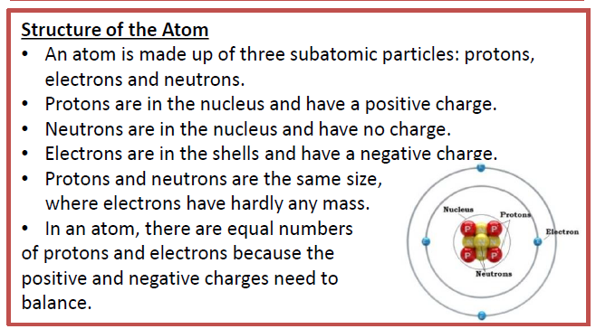
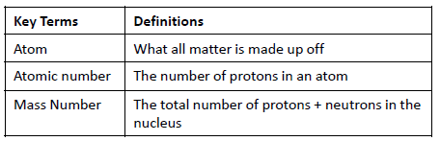
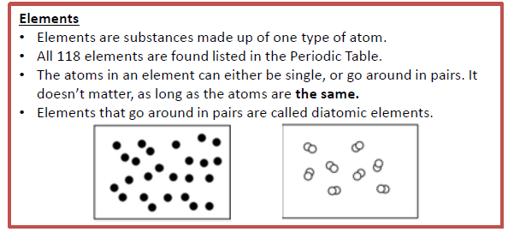
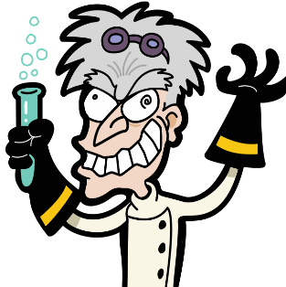
Y7 Atoms, Elements and Compounds
Knowledge Organiser

Slide 2
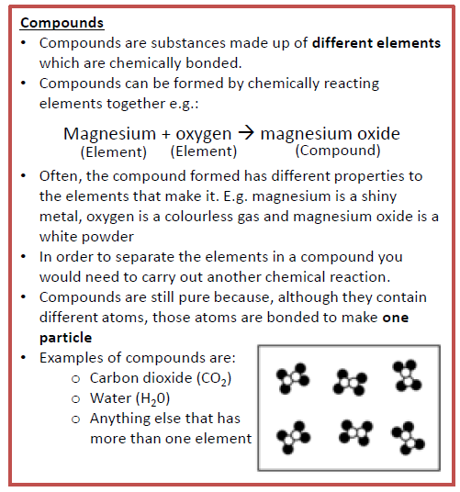
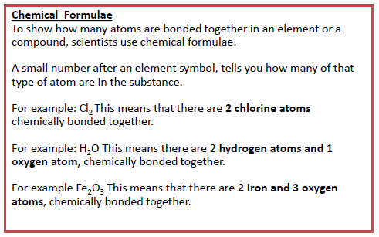
Keywords
1. Atom | The smallest possible piece of an element. Has a radius of 0.1nm (or 1x10⁻¹⁰m)
2. Element | A substance in which all the atoms have the same atomic number
3. Isotope | Atoms with the same number of protons but different numbers of neutrons
4. Molecule | Two or more atoms bonded together
5. Compound | Two or more different atoms bonded together
6. Mixture | At least two different elements or compounds together. Can be separated easily
7. Nucleus | The centre of an atom. Contains protons and neutrons
8. Proton | A positively charged particle found in the nucleus
9. Neutron | A neutral particle found in the nucleus. Has no charge
10. Electron | A negatively charged particle found in energy levels (shells) around the nucleus

