Slide 1
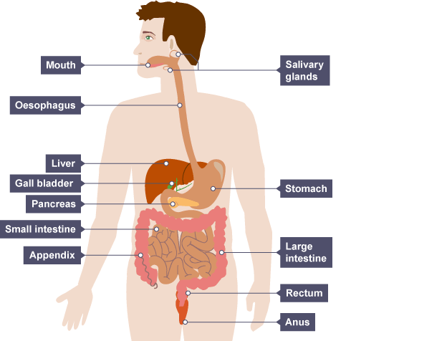
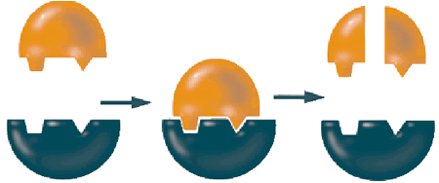
Health and Lifestyle
Absorb | Movement of a substance across a cell membrane
Active site | The area of the enzyme with the specific shape to make the reaction happen with the substrate(s)
Carbohydrate | Food group used as a source of energy
Catalyst | Chemical that speeds up a reaction
Denature | When an enzyme has its shape changed so it no longer works
Digestive enzyme | Enzymes which speed up the process of digest
Enzyme | A biological catalyst. One type of enzyme does one specific reaction
Lipid | Other name for fats, needed as a source of energy
Product | Chemical made during a reaction
Protein | Needed for growth and repair
Substrate | The chemical(s) which are involved in the enzyme catalysed reaction
Digestion is the breakdown of carbohydrates, proteins and fats into small soluble substances to be absorbed into the blood.
The Digestive System
Mouth | Mechanical breakdown/chew food
Salivary glands | Produce saliva with amylase enzymes to breakdown starch
Oesophagus | Push chewed food to stomach
Stomach | Partial digestion of food/mechanically churns food with HCl and protease enzymes
Pancreas | Produces digestive enzymes
Liver | Produces bile
Gall bladder | Stores bile which breaks down fats (lipids) and neutralises the HCl(stomach acid)
Small intestine | Absorption of small soluble particles
Large intestine – colon | Where water is reabsorbed
Large intestine – rectum | Muscular section of the large intestines
Large intestine – anus | Where faeces leave the body
Types of Enzymes
Enzymes
Food Tests
Enzymes are proteins that function as biological catalysts. They can break down larger molecules into smaller, soluble molecules that can be absorbed in the small intestine.
Organisms use enzymes to control chemical reactions.
Enzymes are catalysts, so they speed up chemical reactions.
They have an active site with a specific shape. A specific molecule slots into the active site (like a key into a lock) and the reaction takes place.
Test for | Chemical | Result
Sugar | Add Benedict’s solution | Turns brick red (or orange with less sugar)
Protein | Add Biuret solution | Turns purple
Starch | Add iodine | Turns blue black
Enzyme | Substrate | End product | Where produced
Protease | Protein | Amino acids | Stomach, pancreas
Lipase | Lipids | Fatty acids and glycerol | Pancreas
Amylase | Carbohydrates (starch) | Simple sugars | Mouth, small intestine

Slide 2
