Slide 1
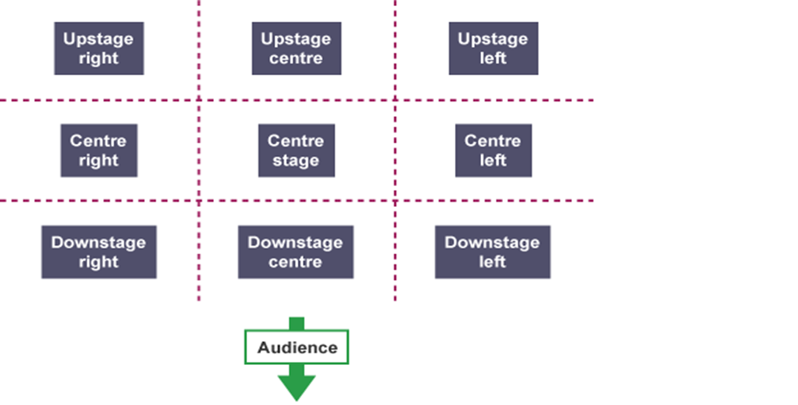
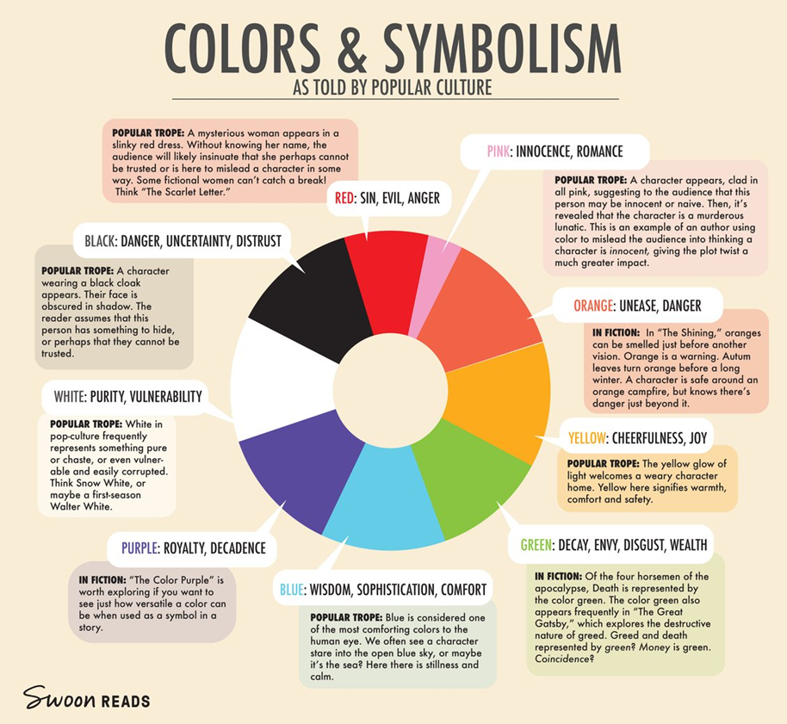
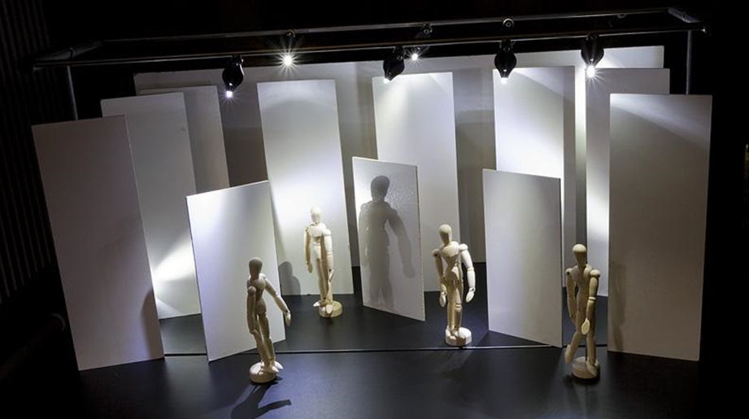
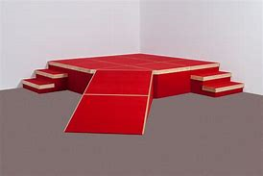
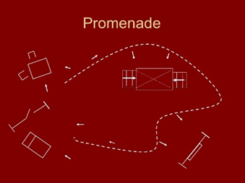
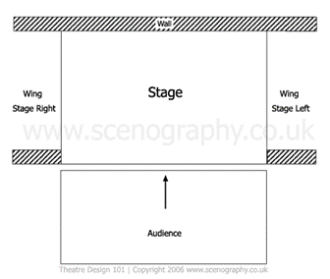
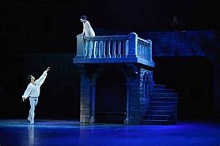
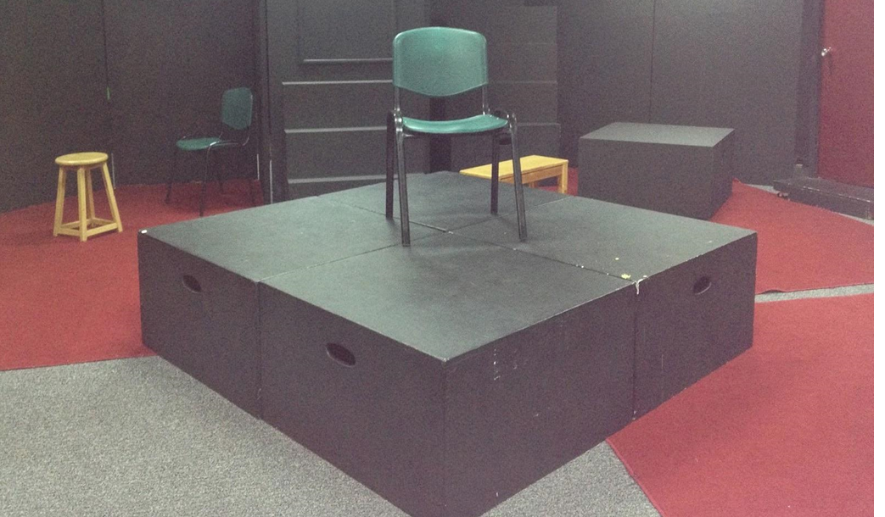
DESIGN KNOWLEDGE
ORGANISER
location, mood/atmosphere, period, symbolism
COSTUME DESIGN
USE THE ANAGRAM
Colour - How does colour reflect/symbolise personality or social status? Condition - The state of something with regard to its appearance, quality, or working order. Cut - The way or style in which a garment is cut.
e.g. "the elegant cut of his dinner jacket" Ornamentation - Decorative elements added to something to enhance its appearance. Style - A distinctive appearance. Texture - The feel, appearance, or consistency e.g. we naturally associate smooth silky fabrics with the rich, and rough, hairy ones with the poor. Un(fit) - Be of the right shape and size (or not). Material - Cloth or fabric; the matter from which a thing is or can be made. Expressing…?- What it expresses/tells us about the character
Other aspects of costume design that should be considered:
Hair, wigs, stage make up, accessories, jewellery, personal props, masks, suitability of movement (i.e. if the piece is highly physical, will the costume help or hinder the performer’s physical movement?)
Remember also, all research and designs should initially begin with a moodboard - an arrangement of images, materials, pieces of text, etc. intended to evoke or project a particular style or concept.
Stage positioning
COLOURS AND SYMBOLISM
Stage Types
FLATS
RAMPS & STEPS
BALCONY
BLOCKS
End on

Slide 2
DESIGN KNOWLEDGE
ORGANISER
LIGHTING DESIGN
SET DESIGN
Cyclorama - A cloth stretched tight in an arc around the back of a stage set, often used to depict the sky.
Gauze - A thin transparent fabric of silk, linen, or cotton.
Backdrop - A painted cloth hung at the back of a theatre stage as part of the scenery.
Set dressing - These are the smaller details such as curtains, table cloths, paintings hung on the wall, chairs
Stage furniture – furniture placed on stage.
Revolve - Set that comes on by turning the stage comes on from a ‘revolve’ or is revolved on.
Special effects – These can be used to enhance a set design and may include projection, smoke machine (fog), flame machines, pyrotechnics, confetti, wind machine, etc.
Flying in/out - Set coming from above comes from the fly gallery or is ‘flown in’ (“I would fly in the backdrop”).
Trucking on/off - Set coming on from the side/wing is ‘Trucked on’ (“I would Truck on the desks”).
Marking out/Spike the stage - Sticking tapes to the floor of the rehearsal space to indicate the ground plan of the scenery. Also for marking the position of furniture etc. within a set.
Scenery - The painted background used to represent natural features or other surroundings on a theatre stage
Fresnel – used for a softer edged effect.
Flood – produces a clear wide angled light
Spot – has a hard edged effect.
Strobe – a flashing light used for special effects
Coloured gels and gobos – can be added to the front of some lanterns to throw a coloured light or pictured effect onto the stage
Parcan – used for general cover and can hold a coloured gel or gobo.
Barn doors – adjustable flaps used to shape the light and how it is projected onto the stage.
Birdie– a miniature lantern but provides a surprisingly bright, soft edged pool of light.
Lighting terms:
Spill- an unfocused light
Intensity (high/low) - how bright/dim a lighting state is
Flash/ fade - Flash is a quick change. Fade is a slow change.
Cross flash/ cross fade - When the lights change at the same time.
Open white - This is ‘unfiltered’ light (ie has no gel)
Uplight/ low beam - A light placed or designed to throw illumination upwards.
Back light - Illumination from behind
Practical light - Sources of light that you can see on the stage e.g. candles, torches, mobile phones, head lights, neon signs, etc.
Follow spot - A high-intensity spotlight used to follow action.
Sound terms:
Soundscapes- A mix of sounds to create a location.
Underscoring- Music played in the background to create a mood.
Pre-recorded sound effects - eg a gun firing.
Live sound – Music or sound effects happening live on stage.
Levels (loud or soft)- creates a sense of distance, or could be quiet soundscape, sound might get louder to create tension.
Echo- Sound bouncing off a single surface and being repeated, gives the impression of a wide open space.
Reverb- Sound bouncing off many surfaces, gives the impression of being enclosed- the more reverb the smaller the space.
Fades- how the volume of a sound alters. Music, sound effects or soundscapes can be faded in (gradually made louder) or faded out (gradually made quieter) during a performance.
Panning- When sound may move to come out of different speakers.

