Slide 1
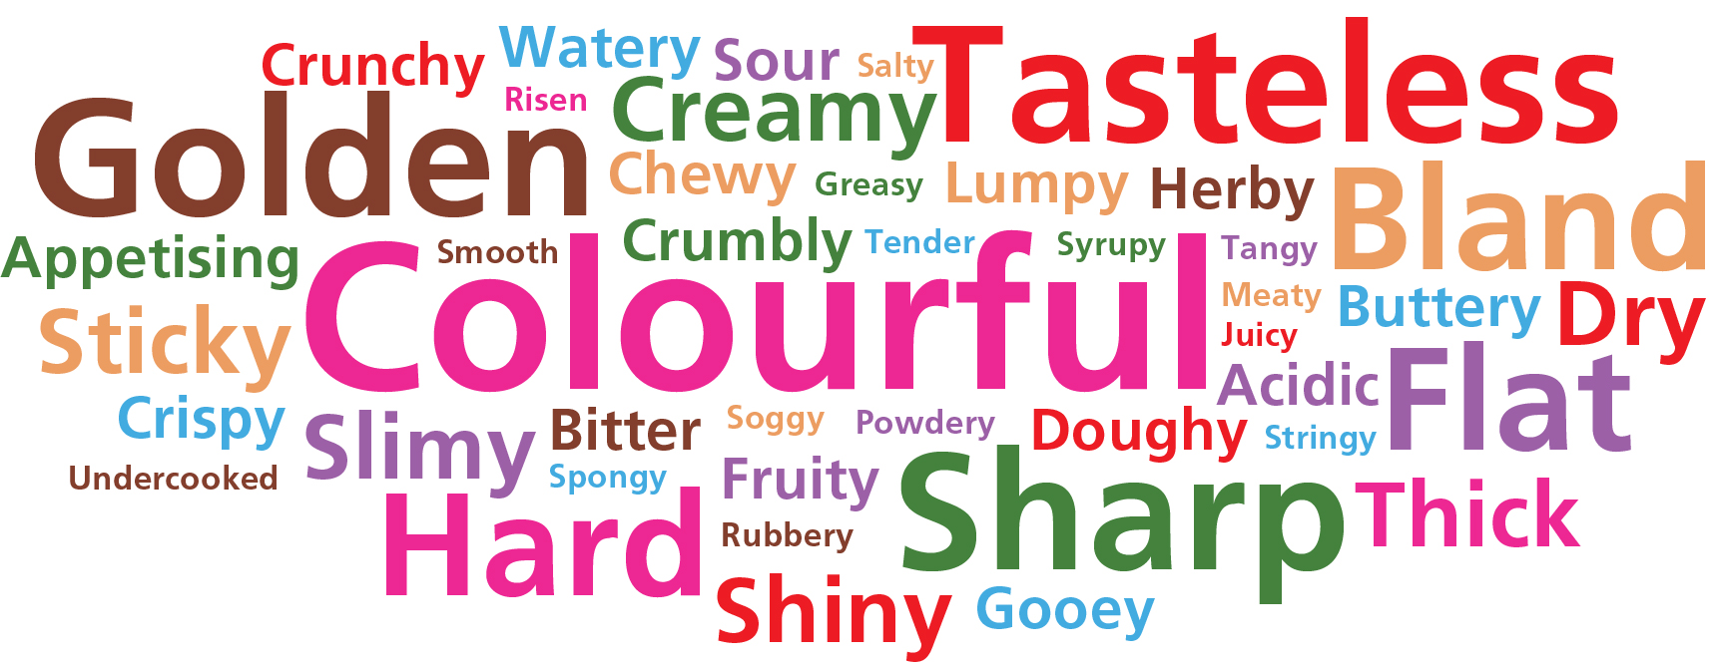
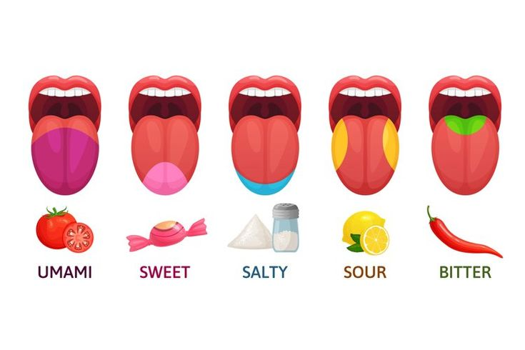
Year 7 - Sensory Evaluation
Sensory evaluation analyses and measures human responses to food and drink, e.g. appearance, touch, odour, texture, temperature and taste.
Sensory evaluation tests should be set up in a controlled way to ensure fair testing, e.g. no distracting colours, noise or smells; same size portions; coded samples, and water to drink.
Preference tests - these types of tests supply information about people's likes and dislikes of a food. They include hedonic, paired comparison and scoring tests.
Discrimination tests - these types of tests aim to evaluate specific attributes, i.e. characteristics of a food (such as crunchiness). They include triangle, duo trio, ranking and paired comparison tests.
Using our senses
A range of senses are used when eating food:
sight;
smell;
hearing;
taste;
touch.
A combination of these senses helps to evaluate a food.
Taste
The tongue can detect five basic tastes:
· bitter; salt; sour; sweet; and umami (savoury).
Texture
Texture can be assessed through touch. When food is placed in the mouth, the surface of the tongue and other sensitive skin reacts to the feel of the surface of the food. This is also known as mouth-feel.
Weekly Tasks
1 – Complete a sensory evaluation on your favourite chocolate bar.
2 – Make a list of foods that are considering sweet or sour.
3 – Choose 10 words from above and match them with foods that you enjoy.
4 – Complete a sensory evaluation of a dish you have made in school this term.
5 – Take 5-10 words from above and find their antonyms (words that mean the opposite.
6 – Draw and label the 5 tastes of a tongue using the diagrams below to help
Smell
The nose detects volatile aromas released from food. An odour may be described by association with a particular food, e.g. herby, cheesy, fishy. The intensity can also be recorded.
Hearing/sound
The sounds of food being prepared, cooked, served and eaten all help to influence our preferences. The sound of eating food can alter our perception of how fresh a food is (e.g. crunchy carrots).
Sight
The size, shape, colour, temperature and surface texture all play an important part in helping to determine your first reaction to a food. Often if a food does not look appetising, then you will not eat it.
Flavour
Smell (odour) and taste work together to produce flavour. This is the reason why people with a blocked nose find it difficult to determine the flavours of foods.

Slide 2
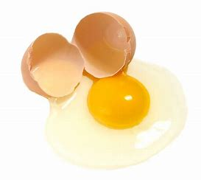
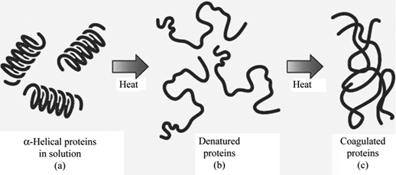
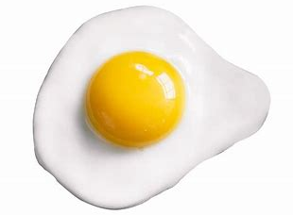
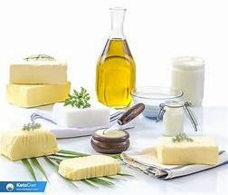
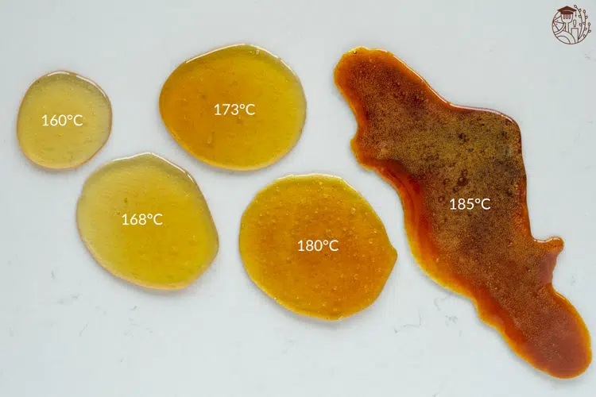
Proteins
Denaturation: The change in structure of protein molecules. The process results in the unfolding of the protein’s structure. Factors which contribute to denaturation are heat, salts, pH and mechanical action.
Coagulation: Coagulation follows denaturation. For example, when egg white is cooked it changes colour and becomes firmer (sets). The heat causes egg proteins to unfold from their coiled state and form a solid, stable network.
Weekly Tasks
Week 1 – Make revision cards for the functional properties of carbohydrates (dextrinisation and caramelisation)
Week 2 – Make revision cards for the functional properties of proteins (denaturation and coagulation).
Week 3 – Make revision cards for the functional properties of fats (aeration and plasticity).
Week 4 – Research the plasticity of fats and how it effects the texture of baked foods.
Week 5 – Link each functional property with at least 2 food products. E.g. dextrinisation – toast.
Week 6 – Draw and label the denaturation and coagulation diagram in your book.
Week 7 – Discuss how each functional property affects the final product when baking a sponge cake.
Functional Properties of Food – Year 8
Ingredients provide a variety of functions in recipes. Carbohydrate, protein and fat all have a range of properties that make them useful in a variety of food products.
These include:
Dextrinisation & Caramelisation of Carbohydrates
Denaturation & Coagulation of Proteins
Aeration and Plasticity of Fats
Carbohydrates
Dextrinisation: When foods containing starch are heated, they can also produce brown compounds due to dextrinisation. Dextrinisation occurs when the heat breaks the large starch polysaccharides into smaller molecules known as dextrins which produce a brown colour.
Caramelisation: When sucrose (table sugar) is heated above its melting point it undergoes physical and chemical changes to produce caramel. The colour goes from light to dark and the flavour becomes more bitter.
Fats
Aeration: Products such as creamed cakes need air incorporated into the mixture in order to give a well-risen texture. This is achieved by creaming a fat, such as butter or baking spread, with sugar. Small bubbles of air are incorporated and form a stable foam.
Plasticity: Fats do not melt at fixed temperatures, but over a range. This property is called plasticity.

Slide 3
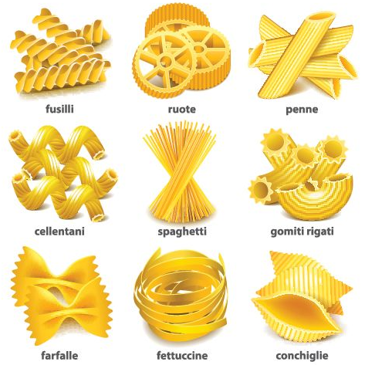
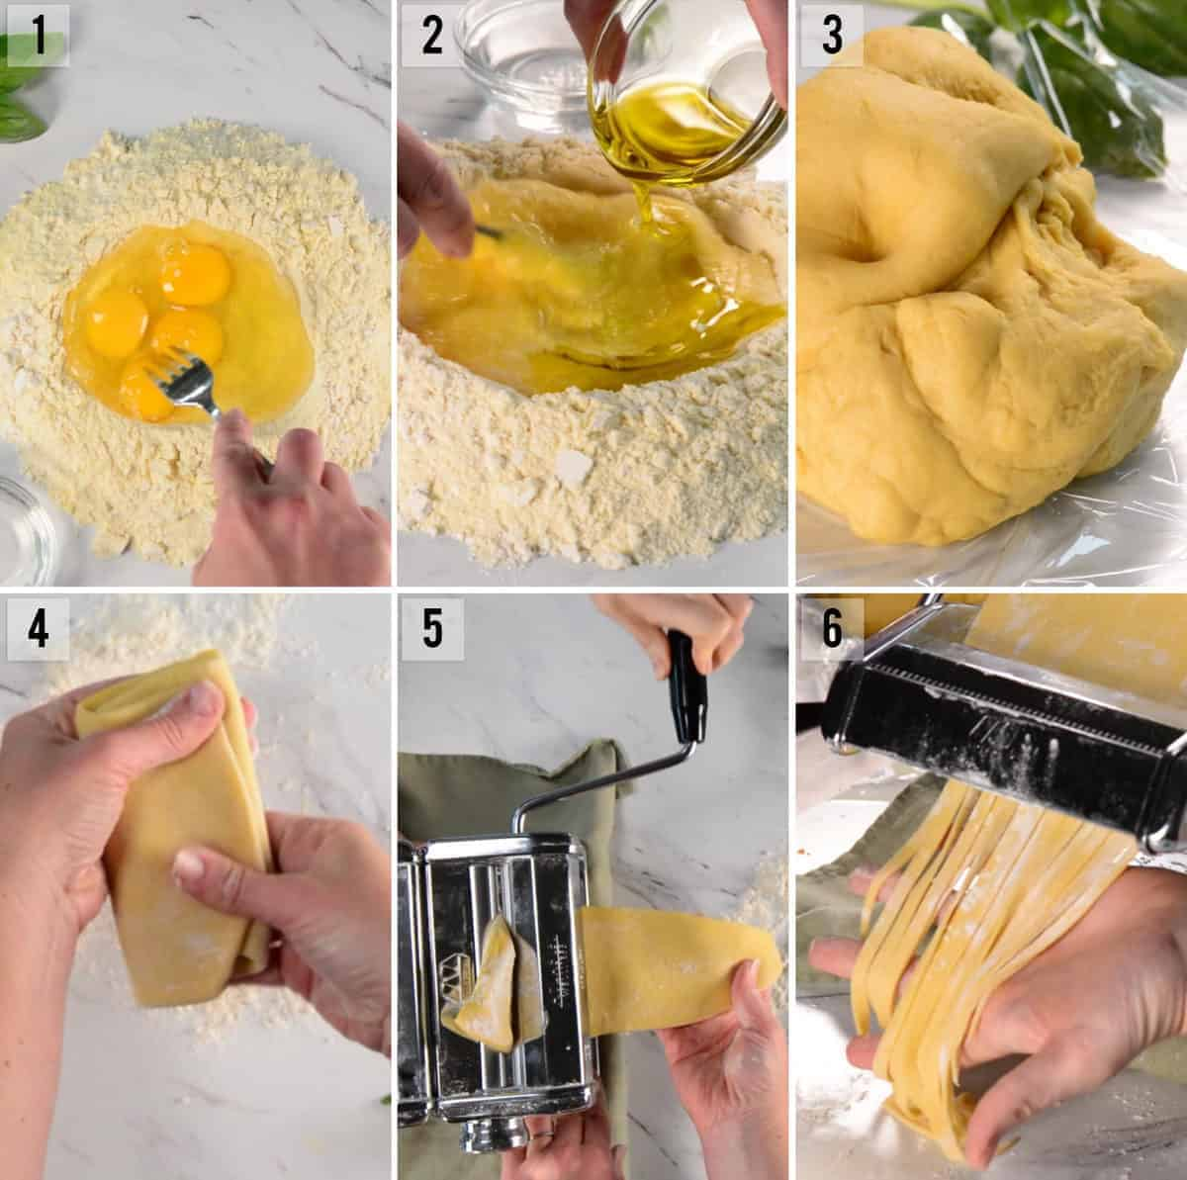
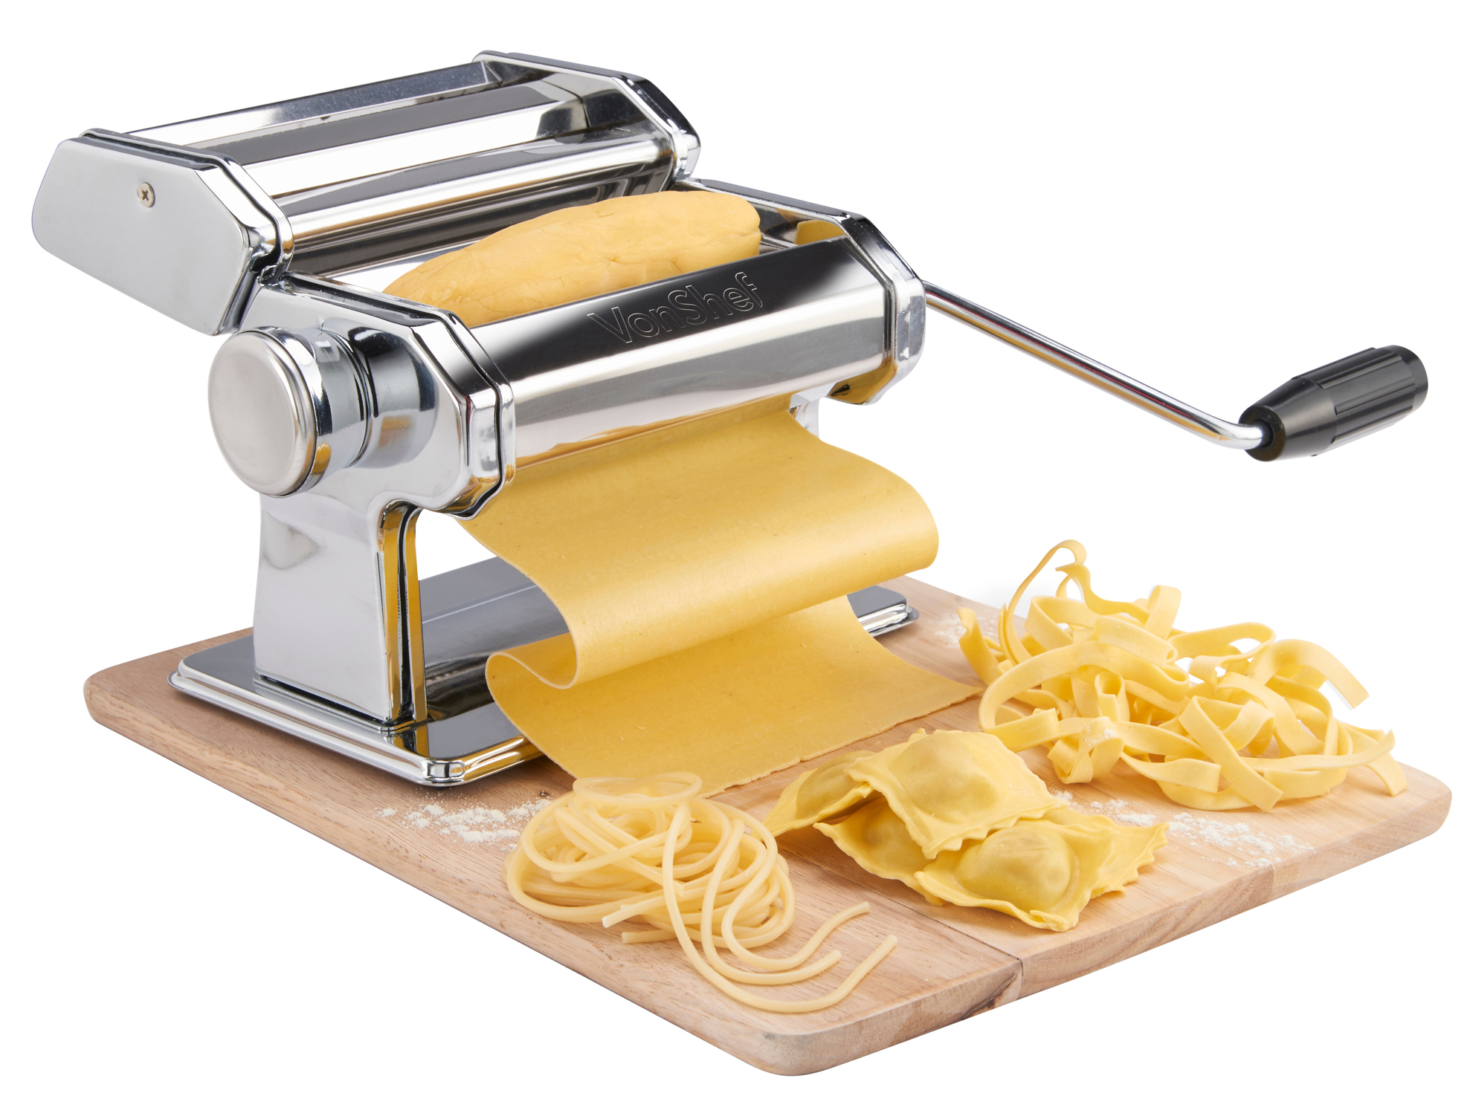
Year 9 - Pasta
Pasta is a type of food typically made from an dough of wheat flour mixed with water or eggs, and formed into sheets or other shapes, then cooked by boiling or baking.
Dried Pasta
Dried pasta is made from durum what flour and water. The dough is needed to develop the gluten and make it strong. It is rolled multiple times before being cut into shapes. The high gluten levels give the pasta a strong structure when dried.
Fresh Pasta
Fresh pasta substitutes water for eggs. The fat from the egg makes the pasta more tender. The durum wheat is not needed as the egg whites provide protein for a strong structure.
Cooking Times
Dried pasta takes longer to cook (9-11 minutes) as the starch granules need to rehydrate fully first.
If fresh pasta is fully hydrated, it cooks in boiling water very quickly (2-3 minutes)
Pairing with Sauces
Fresh pasta has a tender consistency with a buttery flavour, pairing well with creamy cheese sauces.
Dried pasta has a firmer bite so is best cooked al dente and best paired with oily and meaty sauces.
Different Pasta Shapes
Weekly Tasks
Week 1 – Discuss why fresh pasta should be kept in the fridge and has a shorter shelf-life.
Week 2 – Research and list as many pasta shapes as you can find.
Week 3 – List some pasta dishes you have tried and the pasta type/shape that was served.
Week 4 – Using the graphic to the right, create a step by step guide to making and shape fresh pasta.
Week 5 – Discuss the advantages and disadvantages of fresh pasta.
Week 5 – Discuss the advantages and disadvantages of dried pasta.
Fresh Pasta Machine

