Slide 1
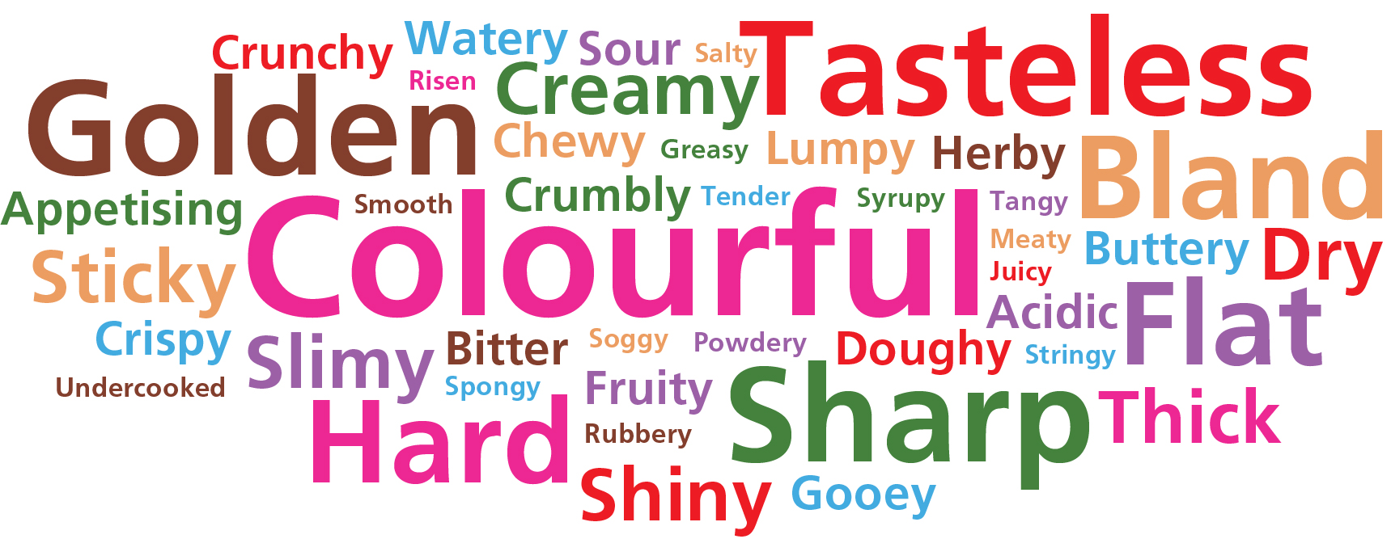
Year 7 – Sensory Evaluation of Fruits and Vegetables
Weekly Tasks
Task 1: Design a set of revision cards for the different types of fruits.
Task 2: Design a set of revision cards for the different types of vegetables
Task 3: Choose your favourite food or snack and carry out a sensory evaluation. Choose 2 words to describe the appearance, aroma, flavour and texture.
Task 4: Create your own sensory word bank like the one in your knowledge organiser. Think of 10 words for each of the senses.
Task 5: Design a pizza with lots of difference toppings. Using the word bank, make a list of tastes you would/wouldn’t like on a pizza.
Key Vocabulary
Sensory Evaluation: judging food on its appearance, aroma, flavour and texture.
Sensory attributes: appearance, aroma, flavour, and texture of foods detectable by our senses, often used to evaluate food quality.
Sensory Descriptor: a word used to describe food by its appearance, aroma, flavour, and texture
Types of Fruits
Fruits are split into different groups:
Soft fruits – strawberries and raspberries
Citrus fruits – oranges, lemons and limes
Stone fruits – peaches, mangos and plums
Tree fruits – apples and pears
Exotic fruits – banana, kiwis and melons
Fruits and Vegetables
We should all aim to have at least 5 portions of a variety of fruit and vegetables each day.
Fruit and vegetables should make up around one third of what we eat each day.
Fruit and vegetables are a very important part of a healthy, balanced diet, as they are good sources of fibre, as well as providing essential vitamins and minerals.
Eating lots of fruit and vegetables can help maintain a healthy weight and having your 5 A DAY could reduce your risk of some diseases.
Types of Vegetables
Vegetables are split into different groups:
Fruit vegetables – aubergine, tomato and cucumber.
Seeds and pods – peas, beans and lentils.
Flower vegetables – broccoli and cauliflower.
Leafy vegetables – spinach, cabbage, and lettuce.
Stem vegetables – asparagus, fennel and celery.
Tubers – potatoes, sweet potatoes and yams.
Fungi – different types of mushrooms.
Bulbs – onions, garlic, shallots and leeks.
Roots – beetroot, swede, carrot and radish.
Sensory Evaluation
When eating food, you are judging the following
characteristics
Appearance (what does the food look like?)
Flavour (what does the food taste like?)
Aroma (what does the food smell like?)
Texture (what does the food feel like?)
Judging food based on these characteristics is
called sensory evaluation.

Slide 2
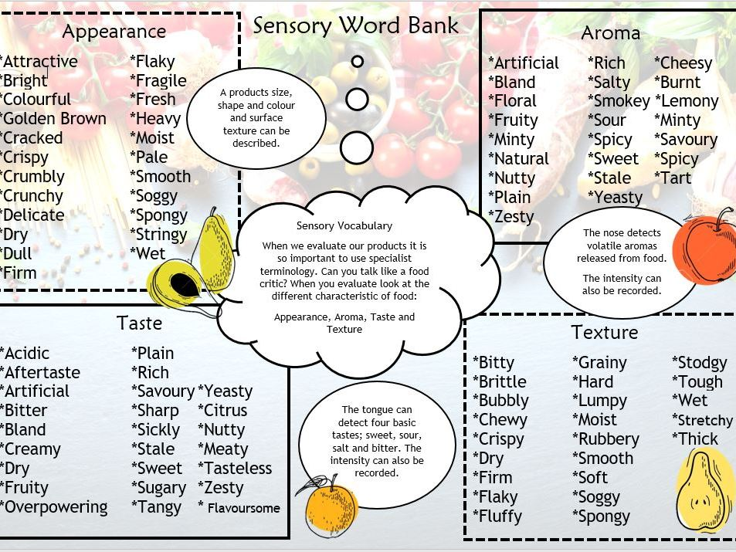
Year 7 – Sensory Evaluation of Fruits and Vegetables

Slide 3
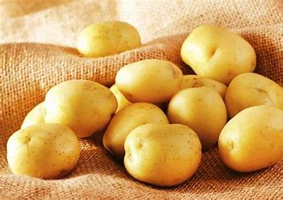
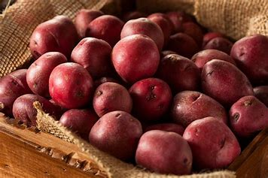
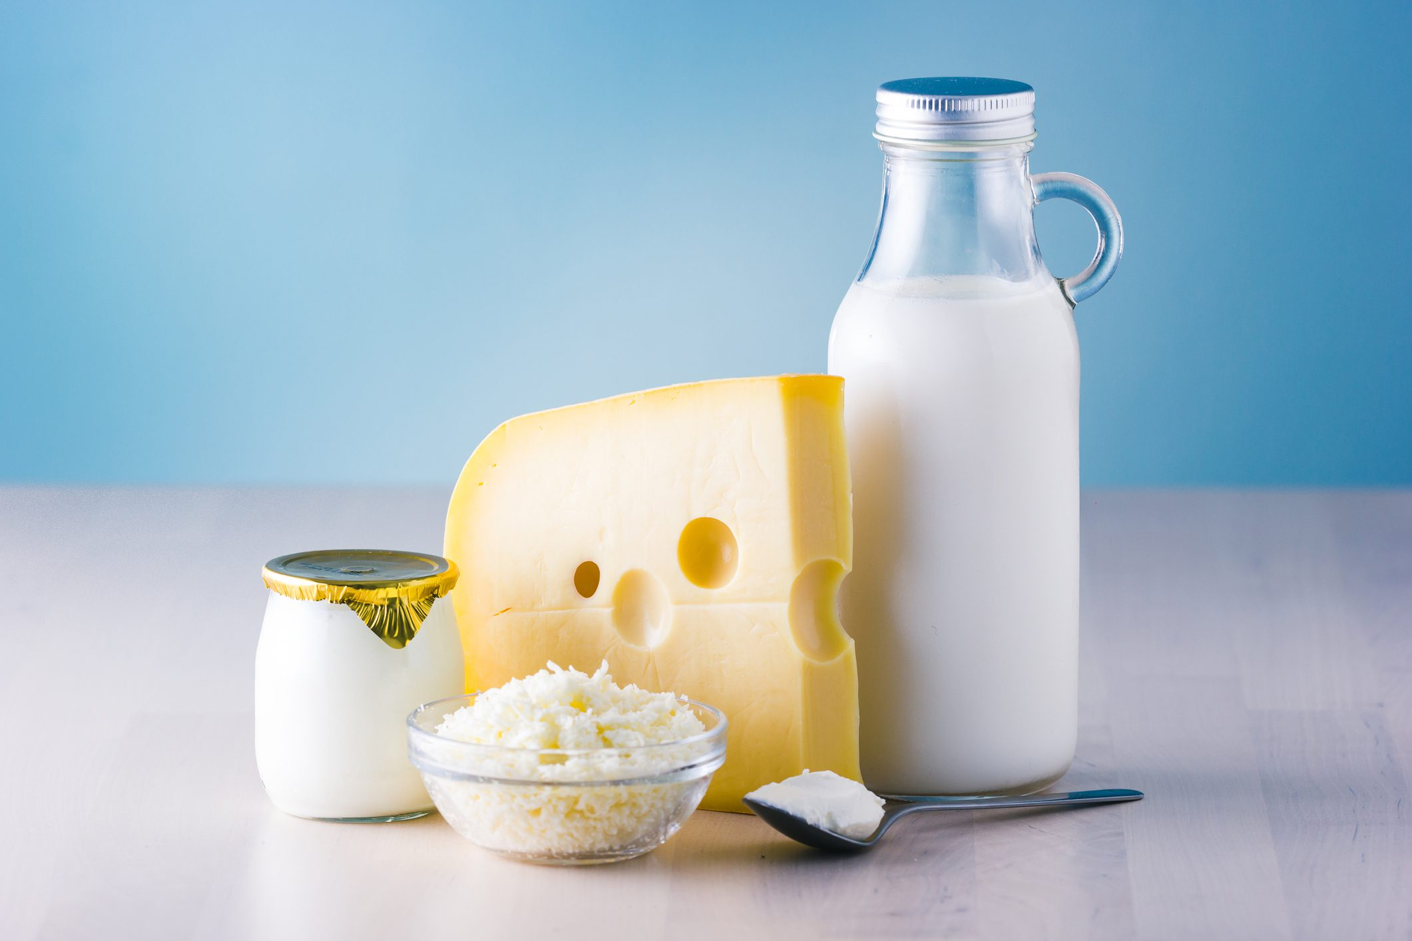
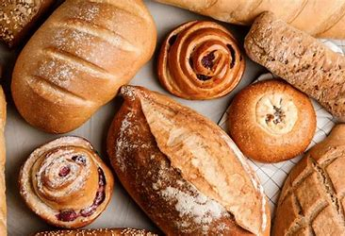
Year 8 – Cereal Grains, Potatoes and Dairy Foods
Key Vocabulary
Cereals – cultivated grasses. The grains are used as a food source.
Gluten – the protein found in wheat.
Fibre – the nutrient found in the cell walls of cereal grains – helps the digestive system.
Potatoes
Although potatoes are vegetables, a potato is actually a tuber. Tubers grow from roots. In the Eatwell guide, potatoes are included in the starchy foods section.
Different potato varieties have different qualities and uses:
Floury Potatoes fall apart when cooked, such as Maris Pipers and King Edward. They are very good for baking and mashing. Recipes using floury potatoes include cottage pie, jackets potatoes, roast potatoes and hash browns.
Waxy Potatoes such as Charlotte or Jersey Royals hold together when steamed or boiled. Recipes using waxy potatoes include potato salad, dauphinoise potatoes and cubed in soups.
Weekly Tasks
Task 1: Make a list of food products that are made with flour – next to the food, say whether it is made with white or wholegrain flour.
Task 2: Research and explain why we need fibre in our diet, and make a list of foods that provide it.
Task 3: List the different type of milk you can buy in a shop. Research and explain what the process of skimming is.
Task 4: Create your own 3 course menu – the starter should contain grains, the main should contain potato, and the dessert should have dairy.
Task 5: List the nutrients that are provided by cereal grains, potatoes and dairy foods. Are you getting enough of these in your diet?
Cereal Grains
Cereal grains grow on cultivated grasses. The grains can be eaten as a food source. Common cereal grains include wheat, oats and rice.
Wheat
Wheat is used in the production of flour and bread products. Flour needs to be processed in order to make flour. This process is called milling. This removes the outer layer of the grain and grinds the grain into flour.
The type of flour depends on the extraction rate – this is the percentage of the wheat grain found in the flour:
100 percent extraction rate is the wholegrain, which provides wholegrain flour.
85 percent extraction rate provides brown flour.
70 percent extraction rate is the wholegrain, which provides white or plain flour.
Dairy Foods
Dairy products are foods made using the milk of a cow, goat or sheep. Cow’s milk is most commonly used to make cheese and yoghurt. Bacteria, called starter cultures, are needed to make cheese and yoghurt. This causes the lactose (sugar in milk) to turn into lactic acid, which adds flavour and makes the product last longer.
These flours can used to make lots of different products including breads, cakes, pasta, and biscuits.

Slide 4
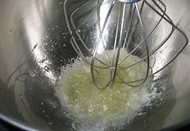
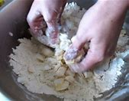
Year 9 – Functional Properties of Fats
Key Vocabulary
Aeration: adding air to a food product.
Plasticity – melting temperature of a fat or lipid.
Shortening – providing a crumbly texture.
Plasticity
Fats do not melt at fixed temperatures, but over a range. This property is called plasticity. It gives all fats unique characteristics. This plasticity is due to the mixture of triglycerides, each with their own melting point. Some products are formulated using fats containing triglycerides with lower melting points so they can spread from the fridge (e.g. soft spread) or melt on the tongue (e.g. chocolate). Other fats have higher melting points and are used for cooking.
Weekly Tasks
Task 1: In your own words explain how aeration affects baked products, provide some examples of foods that require aeration.
Task 2: In your own words explain how plasticity affects the texture of butter and spreads – why is this needed?
Task 3: In your own words explain how shortening affects baked products.
Task 4: Explain the dangers of consuming too much fat in your diet, and the health related problems this could cause.
Task 5: Revise the key words and write them in your book.
Functional Properties of Fats
Fats are an essential part of our diet - eating too much can lead to obesity – but not enough can lead to malnutrition. Fats also have a role is how food products and made, how they taste, and even their structure.
Aeration
Aeration is the process of adding very tiny pockets of air to something. In the case of fats and oils, this is normally done using mechanical/physical means, such as creaming a mixture together using a wooden spoon or using an electric whisk.
The process of allowing air to be combined into ingredients to make them lighter and/or create more volume, which may also be referred to as aeration. For example, sifting flour removes lumps and adds air making the resulting flour and typically the food dish using the flour, lighter in texture and consistency. Beating egg whites adds air, which increases the volume or whipping butter accomplishes the same purpose.
Shortening
Oils and fats are used in a baked product to reduce the development of gluten giving the foods a crumbly texture. The fats and oils break down the gluten into “shorter strands” hence the term shorteners. Coating the flour in fat prevents the flour from absorbing water hindering the formation of gluten. If too much gluten developed, the food would be stretchy and elastic.
Shortening is used in most doughs and batters, to give the baked product a crisp and crumbly texture. Rubbing the fat in causes the baked product to have a flaky texture, as the dough is separated into layers. When fat is whisked with sugar, a process called creaming, the texture will be more like a cake, and be soft and springy.
The type of fat used will also affect the colour of the product. For example, using margarine will give the baked product a golden colour, whereas lard produces a product with a pale yellow colour.

