Slide 1
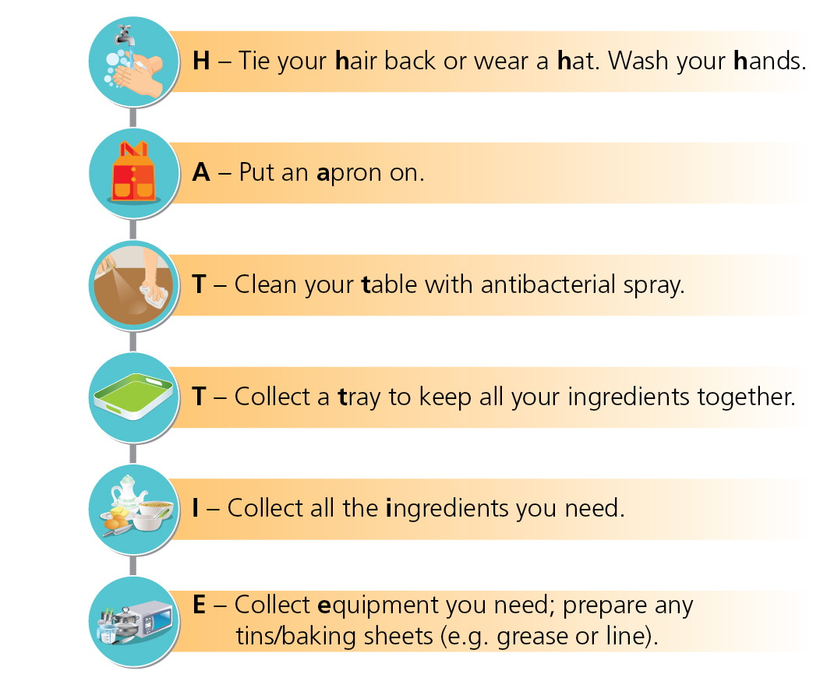
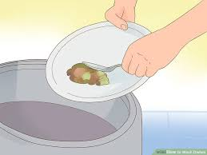
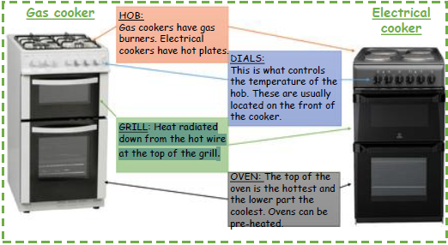
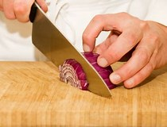
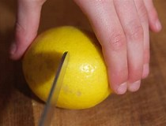
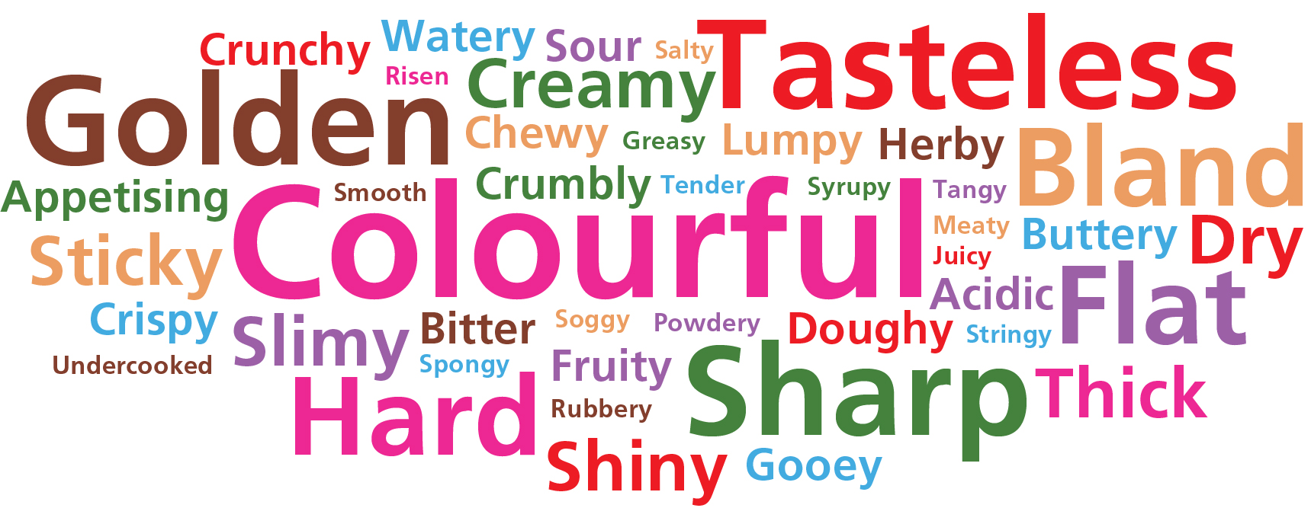
Year 7 - Food And Nutrition
Preparing for practical work - HATTIE
Stages of washing up
Getting Ready
Collect pans, dishes and cutlery & take to the sink area.
Scrape left over food into the food waste bin.
Empty waste liquids down the sink.
Stack everything neatly.
Put on rubber gloves, if available.
Washing and rinsing
Run hot water into the washing-up bowl, adding a small amount of washing-up liquid.
Wash up sharp knives first, dry and return. Don’t let them drop into the washing-up water.
Wash everything else up, the cleanest things first – use a dish cloth or washing-up brush.
Rinse as you go with hot water (or all at once at the end) to remove the bubbles.
Allow to drain, and make sure bowls, cups, etc. are upside down to allow water to drain off them.
Empty the washing-up water out and fill again if it starts to look dirty or feels cold.
Rinse the dirtiest things under a running tap and leave to soak, if necessary.
Dry and put away
Dry with a clean tea towel.
Put everything away in the correct place.
Pick out any bits of food from the plug hole and put in food waste.
Wipe the sink and work surfaces with a hot, soapy cloth.
Always use the bridge or claw technique.
Make sure the knife is clean and sharp.
Use the correct-sized knife for the food you are cutting.
When carrying a knife, carry it by the handle with the point downwards.
Do not leave knives in washing-up bowls, and wash knives separately.
Do not leave knives on the edge of the table or chopping board.
Always cut away from your fingers.
Weekly Tasks
Week 1 – Practice Washing up at home.
Week 2 – Create a poster labelling the safety rules when using knives
Week 3 – Make a list of safety rules for working in the kitchen
Week 4 – Find a picture of an oven or draw a picture of a cooker and label the parts
Week 5 - Create a poster identifying the stages of Hattie
Week 6 – Create a recipe card for Croque Monsieur – list the ingredients , the method and equipment needed
Knife Skills
Claw Grip
Bridge Hold
When you eat food, you are judging the following characteristics
Appearance
Taste – what a food product tastes like
Smell – Aroma
Texture – mouthfeel ( how a food product feels in the mouth)
Judging food based on these characteristics is called sensory evaluation.
Sensory Evaluation
Safety Rules

Slide 2
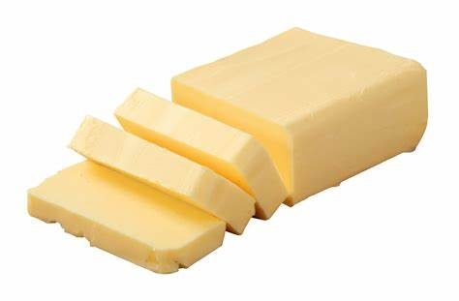
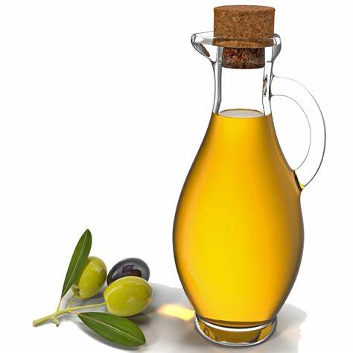
Year 8 - Food And Nutrition
What is fat?
Fat is one of the five nutrients and is an essential part of your diet. However, many people eat too much fat, which is not good for their health.
Fats may also be called oils or lipids. Fats such as butter are solid at room temperature. Oils are liquid at room temperature.
Why is fat important
It keeps the body warm
It provides energy
It provides fat-soluble vitamins
It protects and protects our organs by covering them with fat
Fats may be either:
Animal fats – butter, lard, suet, cream, hard cheese. These are typically saturated
Vegetable fats – sunflower oil, olive oil, rape seed oil, nuts. These fats are typically unsaturated.
Butter
Oil
What happens if we eat too much fat?
Eating foods high in fat can raise cholesterol levels on the blood. Cholesterol is a fatty substance needed for the body to function properly.
Eating too much fat can also lead to obesity, an increased risk of diabetes and hear disease. Most people agree that unsaturated vegetable fats are better for our health.
Saturated animal fats have been linked to increased cases of heart disease.
Key Words
Fat-soluble vitamins – these are vitamins A,D, E and K.
Saturated Fats – usually from animal sources; can be harmful to health
Unsaturated Fats – usually from plant sources; can be good for health.
Cholesterol – a fatty substance which is needed for the normal functioning of the body.
Type 2 diabetes – a build up of fatty deposits in the coronary arteries.
Weekly Tasks
Week 1 – Make a leaflet for suitable for children, showing the main functions of fat.
Week 2 – Describe the key differences between fats and oils.
Week 3 – List the four functions of fat and consider what would happen without fat in our diet.
Week 4 – Make a list of at least 5 different foods that are sources of animal fat.
Week 5 – Make a list of at least 5 different foods that are sources of vegetable fat.
Week 6 – Make a list of fatty foods that you eat as part of your diet – labelling whether they are saturated or unsaturated fats.

Slide 3
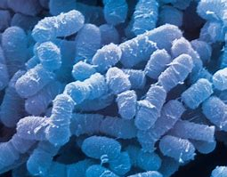
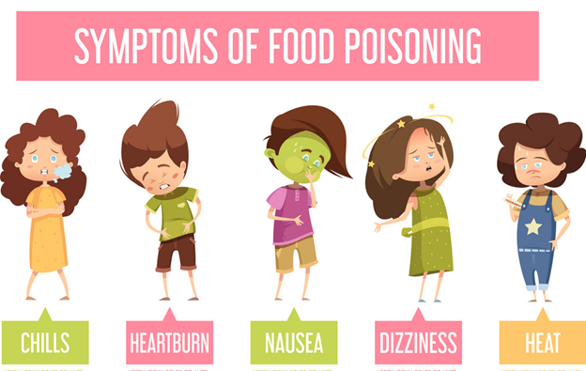
Year 9 - Food And Nutrition
Bacteria come from work surfaces and equipment
Dirty tea towels and dish cloths.
Dirty equipment.
Using the same chopping board for raw and cooked food.
Colour coding of equipment helps to prevent cross-contamination.
What is bacteria?
Bacteria are a group of tiny microorganisms, including some that can cause illness and disease.
If present in foods, they can cause food poisoning.
What are the different types?
Salmonella
Staphylococcus aureus
Bacillus cereus
Listeria monocytogenes
Campylobacter
Bacteria come from food handlers
Handwashing is very important to prevent unclean hands spreading bacteria on to food.
Double-dipping when tasting food passes bacteria from your mouth into the food.
Licking fingers, touching the face and hair, and picking the nose may all contaminate food, dishes and equipment.
Bacteria comes from raw foods
Raw meat, poultry and their juices.
Eggs and shellfish carry bacteria on their shells, both inside and outside.
Soil on foods such as uncooked rice and root vegetables.
Weekly Tasks
Week 1 – Explain the different ways you can prevent the spread of bacteria during practical lessons.
Week 2 – Choose three of the listed bacteria types and find out where they are found using the internet.
Week 3 – Discuss the different ways you can prevent pests in the kitchen (E.g. rats, flies, etc)
Week 4 – Draw the outline of a human and label all the different body parts that bacteria can be spread from.
Week 5 – Design a poster warning about the dangers of bacteria and food poisoning.
Bacteria comes from waste food
Bins with no lids attract pests.
Thin bin bags can split and contaminate areas.
Rubbish sometimes overflows.
Dirty bins allow bacteria to multiply.
Bacteria comes from pests
This is more likely to happen when:
food is left uncovered
bins are overflowing
areas and equipment are not cleaned properly.

