Slide 1


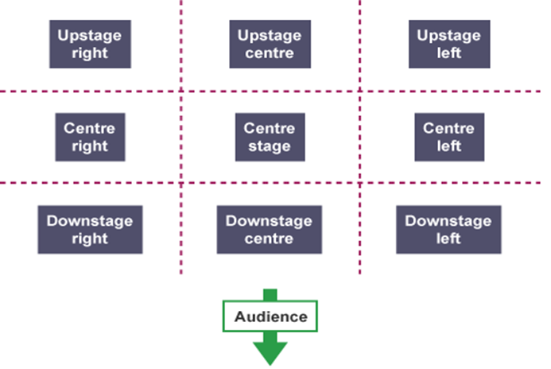


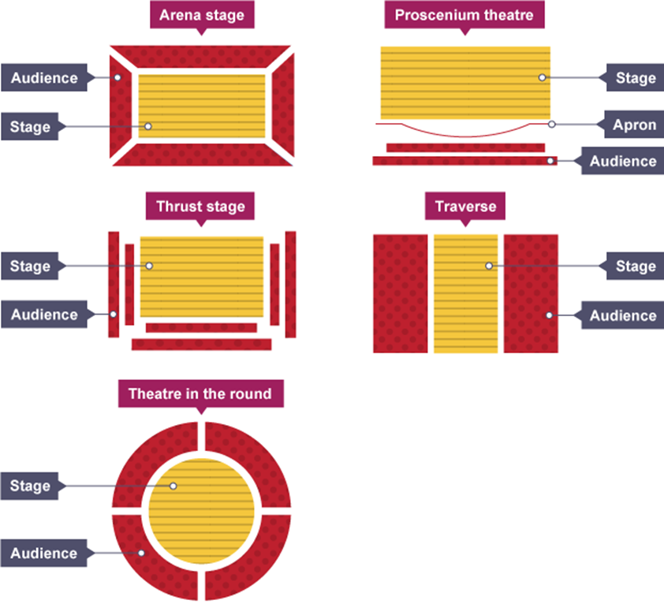



Stage positioning
The scheme in focus during this half term is:
The stones
Preparing for
GCSE DRAMA!
New Skill/Technique Retrieval
Knowledge/ skill | Definition
Mime | The theatrical technique of expressing an idea or mood or portraying a character entirely by gesture and bodily movement without the use of words.
Characterisation | Developing and portraying a personality through voice and movement.
Verbatim | A form of documented theatre in which plays are constructed from the precise words spoken by people interviewed about a particular event or topic.
Subtext | This is content underneath the dialogue. Under dialogue, there can be conflict, anger, competition, pride, showing off, or other implicit ideas and emotions. Subtext is the unspoken thoughts and motives of characters — what they really think and believe.
Monologue | A speech by one actor, performed to the audience – tells the audience what the character is thinking, feeling and the situation they may be in.
Thought tunnel/ conscience alley | Provides the opportunity to explore a decision, problem or dilemma. A useful strategy for exploring any kind of dilemma faced by a character. The class forms two lines facing each other.
Theatre in education | Theatre in Education (TiE) is a process that uses interactive theatre/drama practices to help aid the educational process
Vocal Skills | When an actor changes the tone/pitch of their voice to suit the character they are playing
Direct address | Speaking directly to the audience to break the fourth wall and destroy any illusion of reality.
Movement | Where we move to on and around the stage avoiding the blocking another actor.
Alienation effect | It involves the use of techniques designed to distance the audience from emotional involvement in the play through jolting reminders of the artificiality of the theatrical performance.
Transition | This is the process in which something changes from one state to another
Gesture | In acting gesture is defined as a sign that communicates a character's action, state of mind and relationship with other characters to an audience.
Stage Types
Task 1: Research Shakespeare's ‘The Globe Theatre’.
Write down 3 interesting facts about it and share with your family!
Scan the QR code and complete the tasks!

Slide 2






Setting you up for GCSE Drama Success – the knowledge in this table is KEY for Section A of Component 1 of the GCSE course! Join our Cloud 9 Crew!
Role and responsibilities
Playwright | This is the name given to the person who writes the play.
Performer | A performer is an actor or entertainer who realises a role or performance in front of an audience.
Understudy | An actor who studies another’s role so that they can take over when needed.
Lighting designer | The lighting designer is responsible for designing the lighting states and, if required, special lighting effects for a performance. The final design will result in a lighting plot which is a list of the lighting states and their cues.
Sound designer | The sound designer is responsible for designing the sound required for a performance. This may include underscoring, intro and outro music as well as specific effects. The final design will result in a sound plot which is a list of the sounds required and their cues.
Set designer | The set designer is responsible for the design of the set for a performance. They will work closely with the director and other designers so that there is unity between all the designs and the needs of the performance.
Costume designer | The person who designs the costumes for a performance. The costume department of a theatre is often called the wardrobe.
Puppet designer | The person who designs the puppets for a performance.
Technician | A person who works backstage either setting up technical equipment such as microphones or rigging lights before a production or operating technical equipment during a performance.
Director | A director is in charge of the artistic elements of a production. A director will often have the initial creative idea (‘concept’) for a production, will work with the actors in rehearsal, and will collaborate with designers and the technical team to realise this idea in performance.
Stage manager | The Stage Manager is in charge of all aspects of backstage, including the backstage crew. They will oversee everything that happens backstage before, during and after a performance. During the rehearsal period, the Stage Manager and their team will make sure that all props are found or made, scene changes are rehearsed and smooth, and all other aspects of backstage are prepared. They are also in charge of the rehearsal schedule.
Theatre manager | This is the person who is responsible for and manages the front-of- house team who deal with the audience during the production (for example, the box office manager, ushers and similar staff).
Week 1 | Week 2 | Week 3 | Week 4 | Week 5 | Week 6
Scan the QR Code and watch the video: | Scan the QR code and catch up on The Drama Maga-Scene issues! | Sketch out the different stage types and match them with the right title. | Read the following Article:What is Theatre in Education and five reasons how it supports organisations to inspire positive change. | Scan the QR Code and explore the Bitesize AQA Drama GCSE space | What stage position are our pesky drama faces covering? Create your own ‘Stage Position Puzzle’ and test your family!

