Slide 1

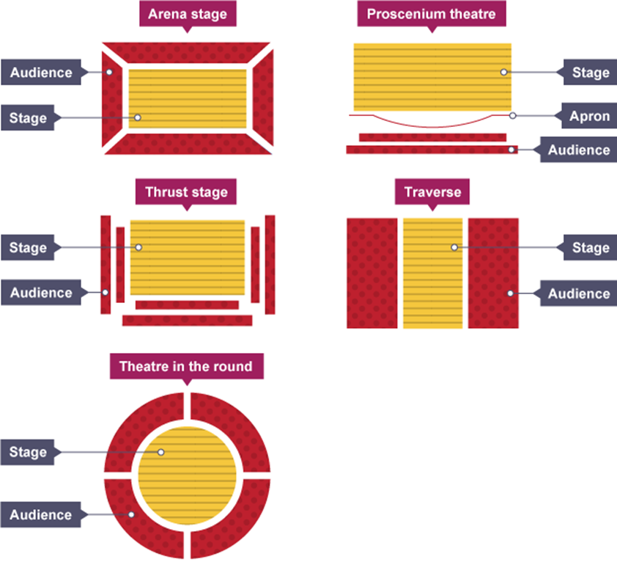

Stage Types
The scheme in focus during this half term is:
The
Last Resort
Preparing for
GCSE DRAMA!
New Skill/Technique Retrieval
Knowledge/ skill | Definition
Mime | The theatrical technique of expressing an idea or mood or portraying a character entirely by gesture and bodily movement without the use of words.
Characterisation | Developing and portraying a personality through voice and movement.
Choral work/ chorus | A group of performers who comment on the main action, typically speaking and moving together
Soundscape | A collection of sounds created either by the actors themselves or by other means like cd/computer.
Synchronisation | The activity of two or more things moving at the same time or rate.
Body as a prop | Using your body to create props and objects on stage.
Promenade theatre | an alternative genre of performance where the audience walks from scene to scene, sometimes interacting and other times observing
Vocal Skills | When an actor changes the tone/pitch of their voice to suit the character they are playing
Direct address | Speaking directly to the audience to break the fourth wall and destroy any illusion of reality.
Theatre in the round | A stage type where the audience sit around the stage and the action takes place in the middle
Choral Work | The chorus in Classical Greek drama was a group of actors who described and commented upon the main action of a play with song, dance, and recitation.
Movement | Where we move to on and around the stage avoiding the blocking another actor.
Narration | A commentary delivered to accompany a performance.
Transition | This is the process in which something changes from one state to another
Gesture | In acting gesture is defined as a sign that communicates a character's action, state of mind and relationship with other characters to an audience.
Tasks
Week 1 | Create a Theatre Etiquette poster
Week 2 | Create a Physical & Vocal Skills quiz and host with family!
Week 3 | Create a quiz on all the Knowledge/Skills you are acquiring this term and practice with the family
Week 4 | Create a costume design for a performer playing the role of one of the donkeys
Week 5 | Sketch out the different stage types and match them with the right title
Week 6 | Listen to Fleetwood Mac ‘Albatross’ and write down all the words/phrases that come to mind.
Week 7 | Make a quiz out of the Roles and Responsibilities terms and practice with the family – this is a key part of Section A of the GCSE Drama Exam!

Slide 2
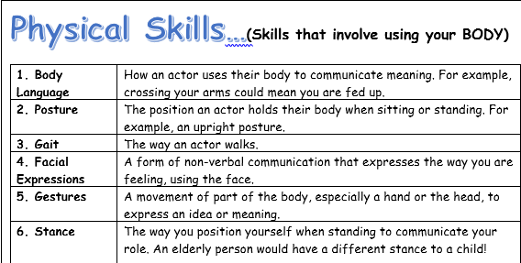
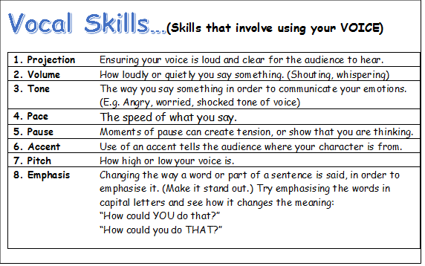
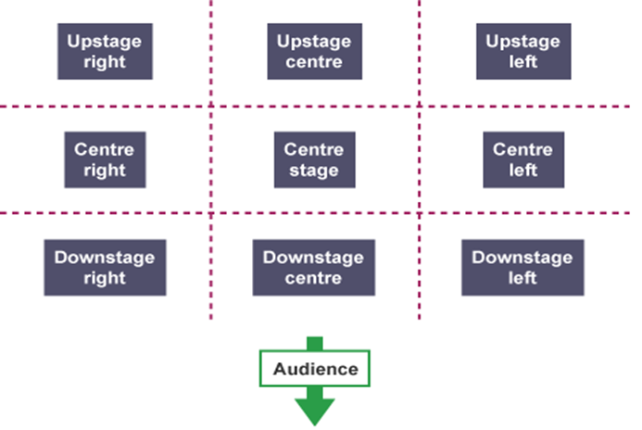

Role and responsibilities
Playwright | This is the name given to the person who writes the play.
Performer | A performer is an actor or entertainer who realises a role or performance in front of an audience.
Understudy | An actor who studies another’s role so that they can take over when needed.
Lighting designer | The lighting designer is responsible for designing the lighting states and, if required, special lighting effects for a performance. The final design will result in a lighting plot which is a list of the lighting states and their cues.
Sound designer | The sound designer is responsible for designing the sound required for a performance. This may include underscoring, intro and outro music as well as specific effects. The final design will result in a sound plot which is a list of the sounds required and their cues.
Set designer | The set designer is responsible for the design of the set for a performance. They will work closely with the director and other designers so that there is unity between all the designs and the needs of the performance.
Costume designer | The person who designs the costumes for a performance. The costume department of a theatre is often called the wardrobe.
Puppet designer | The person who designs the puppets for a performance.
Technician | A person who works backstage either setting up technical equipment such as microphones or rigging lights before a production or operating technical equipment during a performance.
Director | A director is in charge of the artistic elements of a production. A director will often have the initial creative idea (‘concept’) for a production, will work with the actors in rehearsal, and will collaborate with designers and the technical team to realise this idea in performance.
Stage manager | The Stage Manager is in charge of all aspects of backstage, including the backstage crew. They will oversee everything that happens backstage before, during and after a performance. During the rehearsal period, the Stage Manager and their team will make sure that all props are found or made, scene changes are rehearsed and smooth, and all other aspects of backstage are prepared. They are also in charge of the rehearsal schedule.
Theatre manager | This is the person who is responsible for and manages the front-of- house team who deal with the audience during the production (for example, the box office manager, ushers and similar staff).
Stage Positioning
BBC Bitesize ‘KS3 Drama’ Quiz:

