Slide 1

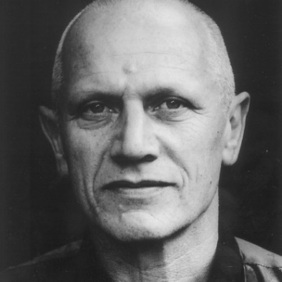



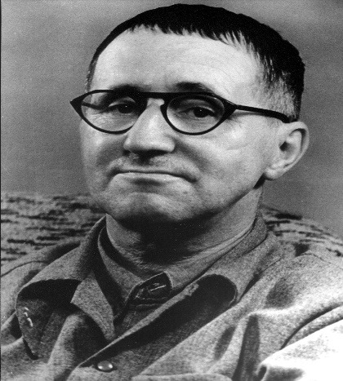


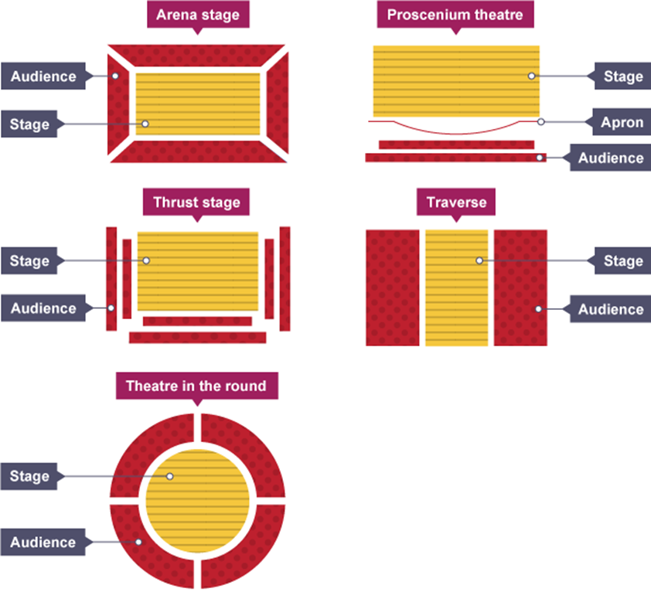
We are focusing on two practitioners in particular this term!
The scheme in focus during this half term is:
Theatre Practitioners
Preparing for
GCSE DRAMA!
Steven Berkoff
New Skill/Technique Retrieval
Knowledge/ skill | Definition
Alienation effect | It involves the use of techniques designed to distance the audience from emotional involvement in the play through jolting reminders of the artificiality of the theatrical performance.
Didactic | Designed or intended to teach.
Split role | This is where more than one actor plays the same character. For instance, the actor playing the main character might rotate from scene to scene.
Ensemble work | an approach to acting that aims for a unified effect achieved by all members of a cast working together on behalf of the play, rather than emphasizing individual performances.
Verbatim | A form of documented theatre in which plays are constructed from the precise words spoken by people interviewed about a particular event or topic.
Choral Work | The chorus in Classical Greek drama was a group of actors who described and commented upon the main action of a play with song, dance, and recitation.
Subtext | This is content underneath the dialogue. Under dialogue, there can be conflict, anger, competition, pride, showing off, or other implicit ideas and emotions. Subtext is the unspoken thoughts and motives of characters — what they really think and believe.
Improvisation | A very spontaneous performance without specific or scripted preparation.
Direct address | Speaking directly to the audience to break the fourth wall and destroy any illusion of reality.
Hot seating | A character is questioned by the group about his or her background, behaviour and motivation.
Theatre in education | Theatre in Education (TiE) is a process that uses interactive theatre/drama practices to help aid the educational process
Movement | Where we move to on and around the stage avoiding the blocking another actor.
Thought tunnel/ conscience alley | Provides the opportunity to explore a decision, problem or dilemma. A useful strategy for exploring any kind of dilemma faced by a character. The class forms two lines facing each other.
Direct address | Speaking directly to the audience to break the fourth wall and destroy any illusion of reality.
Gesture | In acting gesture is defined as a sign that communicates a character's action, state of mind and relationship with other characters to an audience.
Bertolt Brecht
We will also be exploring ‘Verbatim’ theatre.
Stage Types

Slide 2








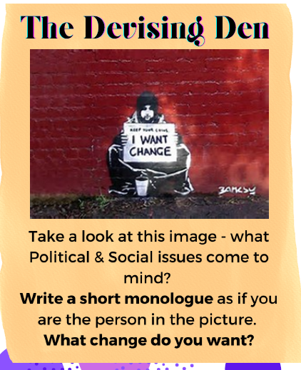


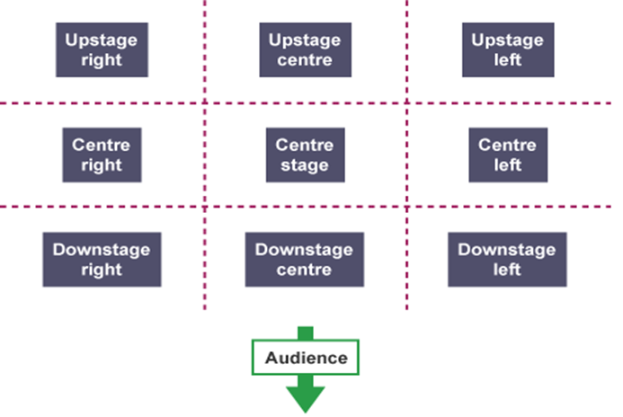







Key Theatre maker terminology for this term
DO NOT put your feet up on the chair in front of you
Turn OFF your phone
DO NOT talk/shout whilst watching a performance/show
Role and responsibilities
Playwright | This is the name given to the person who writes the play.
Performer | A performer is an actor or entertainer who realises a role or performance in front of an audience.
Understudy | An actor who studies another’s role so that they can take over when needed.
Lighting designer | The lighting designer is responsible for designing the lighting states and, if required, special lighting effects for a performance. The final design will result in a lighting plot which is a list of the lighting states and their cues.
Sound designer | The sound designer is responsible for designing the sound required for a performance. This may include underscoring, intro and outro music as well as specific effects. The final design will result in a sound plot which is a list of the sounds required and their cues.
Set designer | The set designer is responsible for the design of the set for a performance. They will work closely with the director and other designers so that there is unity between all the designs and the needs of the performance.
Costume designer | The person who designs the costumes for a performance. The costume department of a theatre is often called the wardrobe.
Puppet designer | The person who designs the puppets for a performance.
Technician | A person who works backstage either setting up technical equipment such as microphones or rigging lights before a production or operating technical equipment during a performance.
Director | A director is in charge of the artistic elements of a production. A director will often have the initial creative idea (‘concept’) for a production, will work with the actors in rehearsal, and will collaborate with designers and the technical team to realise this idea in performance.
Stage manager | The Stage Manager is in charge of all aspects of backstage, including the backstage crew. They will oversee everything that happens backstage before, during and after a performance. During the rehearsal period, the Stage Manager and their team will make sure that all props are found or made, scene changes are rehearsed and smooth, and all other aspects of backstage are prepared. They are also in charge of the rehearsal schedule.
Theatre manager | This is the person who is responsible for and manages the front-of- house team who deal with the audience during the production (for example, the box office manager, ushers and similar staff).
DO NOT get out of your seat unless you have asked a member of staff
DO NOT leave any rubbish behind
BUT DO ENJOY YOURSELVES!
Extra KO Activities
WATCH LIST FOR THIS TERM (IF YOU CAN):
Stage Positioning
A guide to creating Verbatim Theatre:
Bertolt Brecht and Epic Theatre: Crash Course Theatre #4:
A quick introduction to Steven Berkoff

