Slide 1
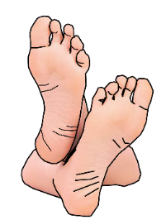
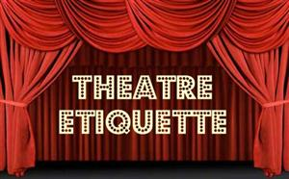
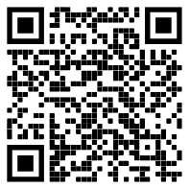
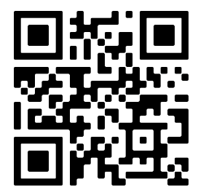
Gateacre Drama Departments: The Drama Maga-Scene
The next scheme of learning is:
Titanic
Turn OFF your phone
DO NOT talk/shout whilst watching a performance/show
DO NOT put your feet up on the chair in front of you
DO NOT leave any rubbish behind
New Skill/Technique Retrieval
Knowledge/ skill | Definition
Stimuli | The starting point, idea or inspiration for your devised drama. It is what you base your drama around.
Sound design | The art and practice of creating sound tracks for a variety of needs in a performance.
Levels | Using different heights or levels onstage creates visual interest. It can also help to ensure that the audience see all of the action. Levels can be used to suggest status - meaning the power or authority one character has over another and can also be used to suggest various locations.
Mime | When an actor performs without the use of dialogue
Improvisation | A very spontaneous performance without specific or scripted preparation.
Placards | A printed or handwritten notice or sign used in a performance often to communicate a message to the audience.
Gait | The way an actor walks
Physical Theatre | Physical theatre is a well-known genre of theatrical performance that encompasses storytelling primarily through physical movement.
Role Play | Role play is the act of imitating the character and behaviour of someone who is different from yourself.
Debate | a formal discussion on a particular matter in a public meeting or legislative assembly, in which opposing arguments are put forward and which usually ends with a vote.
Narration | A commentary delivered to accompany a performance.
Flashback | A flashback is an interjected scene that takes the narrative back in time from the current point in the story.
Hot seating | A character is questioned by the group about his or her background, behaviour and motivation.
Characterisation | Developing and portraying a personality through voice and movement.
Promenade theatre | In promenade theatre there is no formal stage, both the audience and the actors are placed in the same space.
DO NOT get out of your seat unless you have asked a member of staff
Stage Types
Task 1: Research Shakespeare's ‘The Globe Theatre’.
Write down 3 interesting facts about it and share with your family!
Scan the QR code and complete the tasks!

Slide 2
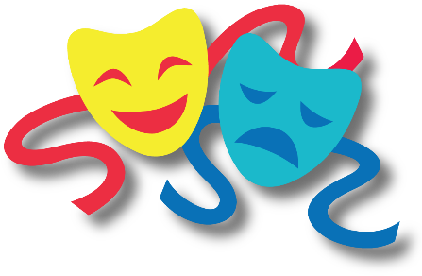
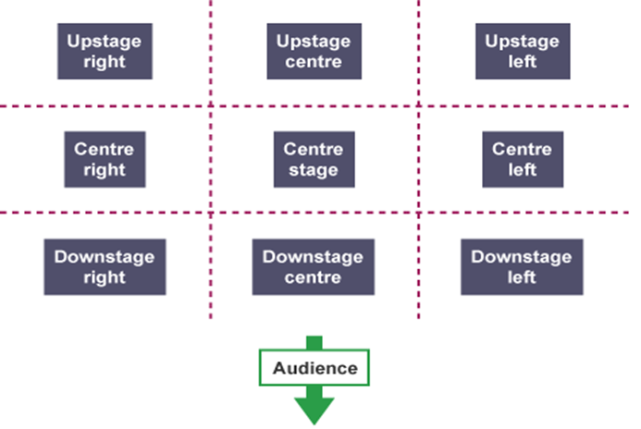
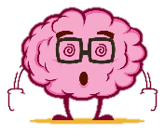
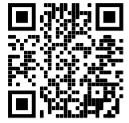
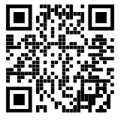
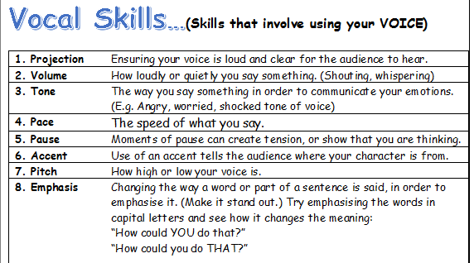
Key performance terminology for this term:
Stage positioning
Tasks
Week 2 | Watch the two videos on the QR codes below and write down new information you have learnt!
Week 3 | What stage position are our pesky drama faces covering? Create your own ‘Stage Position Puzzle’ and test your family!
Week 4 | Write out the skills you have explored so far this term and try, by memory to describe what they are – using your KO only when you feel necessary!
Week 5 | Description: A formal discussion on a particular matter in a public meeting or legislative assembly, in which opposing arguments are put forward and which usually ends with a vote. What is the skill?
Week 6 | You have bagged yourself a 1st class ticket on the Titanic – write a monologue. How are you feeling? What do you expect? Why are you going to America?

