Slide 1
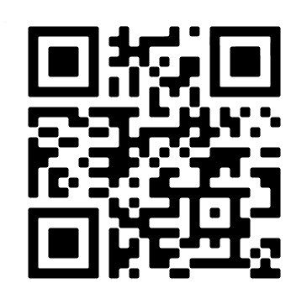
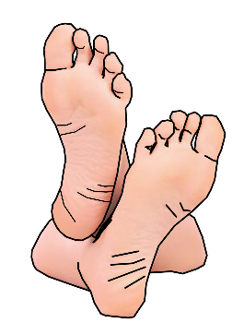
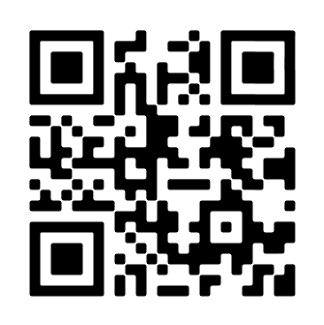
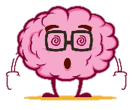
The next two schemes are:
Charlie and the chocolate factory &
Physical Theatre
Have a go at this Bitesize Drama quiz!
What is promenade theatre?
PACE
THE 4 P’S
PITCH
What are the constraints of ‘Theatre in The Round?’
PAUSE
What performance skills can we use to show emotion?
PROJECTION
New Skill/Technique Retrieval
Knowledge/ skill | Definition
Stimuli | The starting point, idea or inspiration for your devised drama. It is what you base your drama around.
Gesture | In acting gesture is defined as a sign that communicates a character's action, state of mind and relationship with other characters to an audience.
Still Image or Freeze frame | This is where the action freezes as if someone has taken a picture midway through a performance. Conveys meaning and highlights the current scene.
Body as Prop | A genre (type) of drama that tells a story using over exaggerated movement. and physicality. Body as Prop Using your body to create props and objects on stage.
Improvisation | A very spontaneous performance without specific or scripted preparation.
Transition | This is the process in which something changes from one state to another
Movement | Where we move to on and around the stage avoiding the blocking another actor.
Physical Theatre | Physical theatre is a well-known genre of theatrical performance that encompasses storytelling primarily through physical movement.
Role Play | Role play is the act of imitating the character and behaviour of someone who is different from yourself.
Promenade theatre | In promenade theatre there is no formal stage, both the audience and the actors are placed in the same space.
Narration | A commentary delivered to accompany a performance.
Slow Motion | Performing in manner whereby the action appears much slower than in real life.
Turn OFF your phone
DO NOT talk/shout whilst watching a performance/show
DO NOT put your feet up on the chair in front of you
DO NOT leave any rubbish behind
DO NOT get out of your seat unless you have asked a member of staff
BUT DO ENJOY YOURSELVES!
WATCH LIST FOR THIS TERM (IF YOU CAN):
Willy Wonka and the Chocolate Factory 1971
Frantic Assembly: What is Physical Theatre?
The Drana Maga-scene:
Charlie and The Chocolate Factory 2005

Slide 2
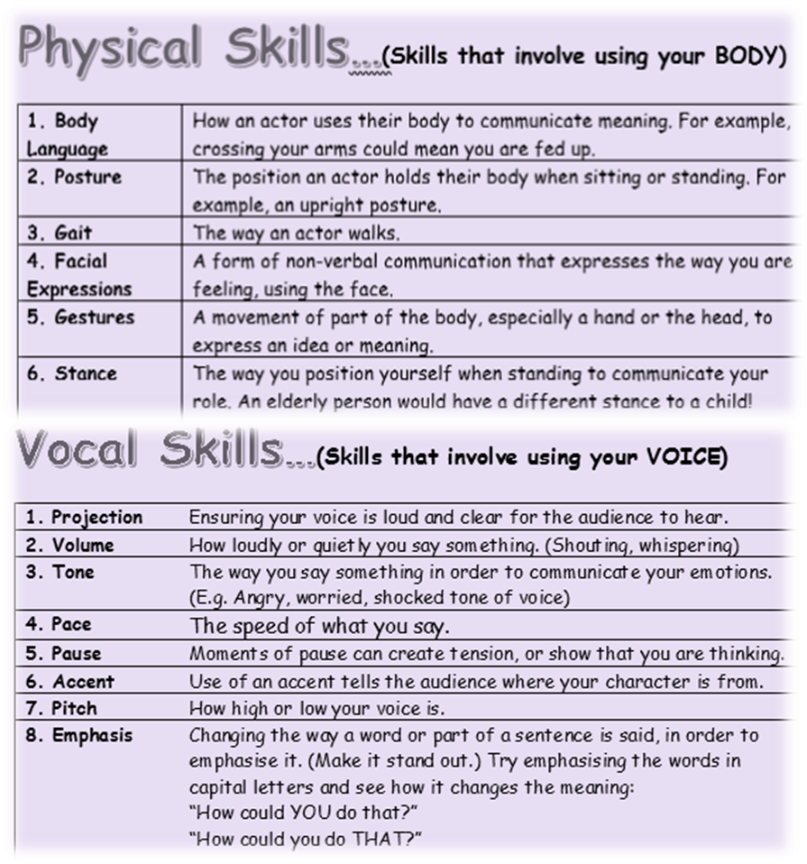
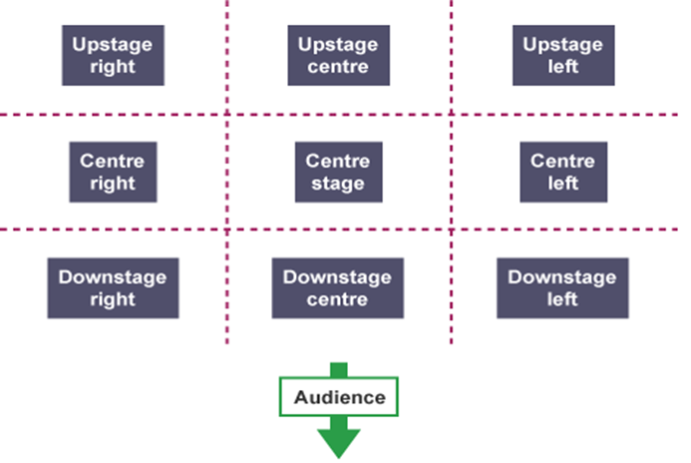
Just some of the skills you will learn/recall upon this term!
Tasks
Week 1 | Watch either version of Charlie & The Chocolate Factory
Week 2 | Design a costume for Willy Wonka with annotations
Week 3 | Where have we placed our Drama heads? Create your own ‘Missing Stage Positioning’ puzzle and test your family!
Week 4 | You have won a golden ticket! Write a monologue on how you feel! Perform it to your family using the physical and vocal skills on this page!
Week 5 | From memory write down what skills you have learnt and put to practice so far this term.
Week 6 | Write a monologue for Charlie after he has been given the chocolate factory – how has his life changed?
Week 7 | Create your own wacky and wonderful confectionary!
New Skill/Technique Retrieval
Stage positioning

