Slide 1
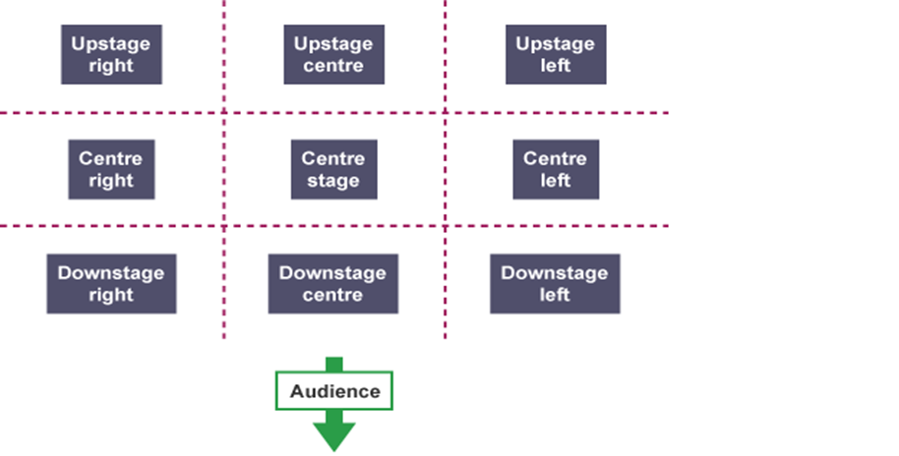
The next scheme
we are
exploring is:
Ernie’s incredible illucinations
Stage Positioning
PACE
THE 4 P’S
PITCH
PAUSE
PROJECTION
Knowledge/ skill | Definition
Stimuli | The starting point, idea or inspiration for your devised drama. It is what you base your drama around.
Hot seating | A character is questioned by the group about his or her background, behaviour and motivation.
Still Image or Freeze frame | This is where the action freezes as if someone has taken a picture midway through a performance. Conveys meaning and highlights the current scene.
Body as Prop | A genre (type) of drama that tells a story using over exaggerated movement. and physicality. Body as Prop Using your body to create props and objects on stage.
Teacher in role | The teacher plays a role. They may ask questions of the students, perhaps putting them into role as well.
Transition | This is the process in which something changes from one state to another
Movement | Where we move to on and around the stage avoiding the blocking another actor.
Storywhoosh/ Action narration | An interactive storytelling technique which enables a story to be brought alive by the storyteller and participants.
Characterisation | Developing and portraying a personality through voice and movement.
Promenade theatre | In promenade theatre there is no formal stage, both the audience and the actors are placed in the same space.
Narration | A commentary delivered to accompany a performance.
Soundscape | A collection of sounds created either by the actors themselves or by other means like cd/computer.
Stage Types

Slide 2
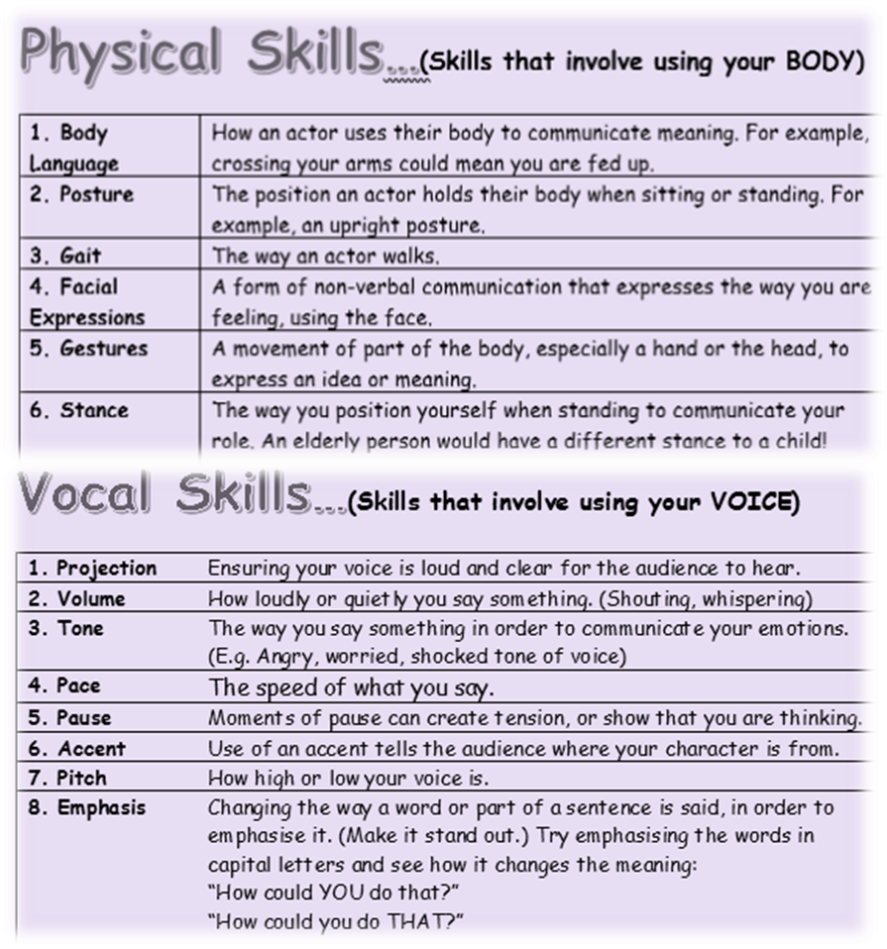
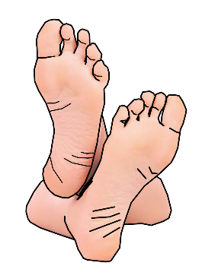
Just some of the skills you will learn/recall upon this term!
Tasks
Week 1 | Create a Theatre Etiquette poster
Week 2 | Sketch out a Theatre in the Round stage
Week 3 | Conduct research on the playwright Alan Ayckbourn
Week 4 | Design a costume for one of the illucinations
Week 5 | Create a Physical & Vocal Skills quiz and host with family!
Week 6 | Write down the main dramatic skills you have learnt so far during this scheme.
Week 7 | Create a costume design for Aunty May in the boxing fight
New Skill/Technique Retrieval
BUT DO ENJOY YOURSELVES!
DO NOT put your feet up on the chair in front of you
Turn OFF your phone
DO NOT talk/shout whilst watching a performance/show
DO NOT leave any rubbish behind
DO NOT get out of your seat unless you have asked a member of staff

