Slide 1
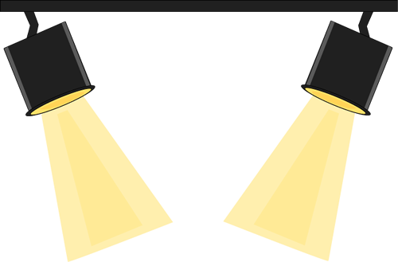


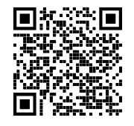

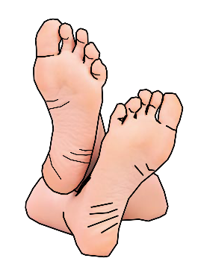

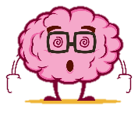





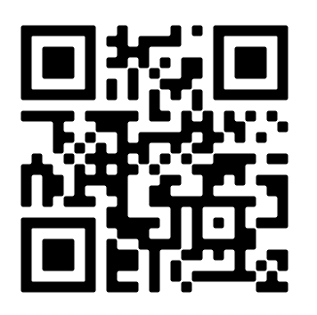








THE 4 P’S
The next scheme
we are
exploring is:
holes
Scan this to access KS3 BBC Bitsize Drama Portal
PACE
PITCH
PAUSE
PROJECTION
Sketch out a Promenade Theatre
RECALL:
Write down 3 rules for a good debate!
DO NOT put your feet up on the chair in front of you
Turn OFF your phone
DO NOT talk/shout whilst watching a performance/show
RECALL:
What performance skills have you already learnt that could be used in a staged debate?
WATCH/READ LIST FOR THIS TERM (IF YOU CAN):
Watch Holes for free by scanning the QR code!
DO NOT leave any rubbish behind
DO NOT get out of your seat unless you have asked a member of staff
BUT DO ENJOY YOURSELVES!
Theatre Etiquette:
Fun Extra Activities
Design a Wanted poster for Kissing Kate Barlow
Design a costume for Kissing Kate Barlow OR The Warden
Write a diary extract in the character of Stanley detailing life at Camp Green Lake
Holes the Book by Louis Sachar

Slide 2

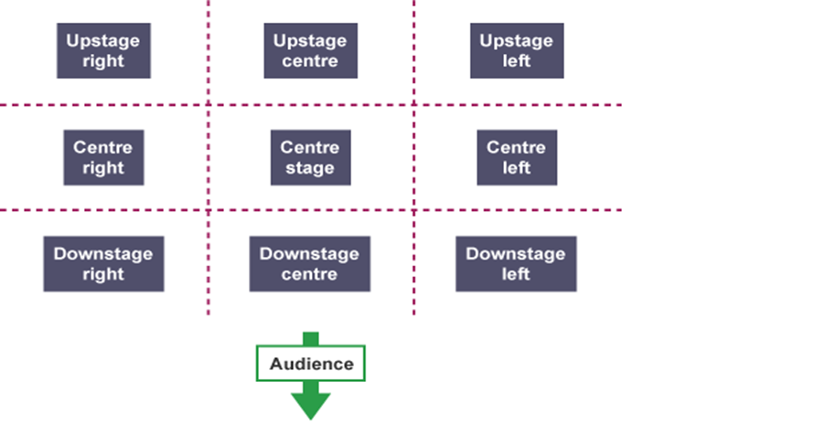
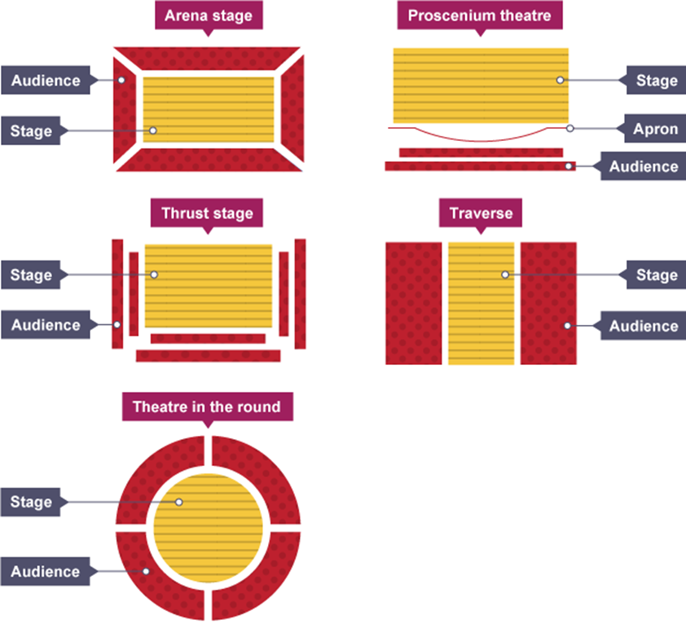
Just some of the skills you will learn/recall upon this term!
Stage Positioning
New Skill/Technique Retrieval
Knowledge/ skill | Definition
Characterisation | Developing and portraying a personality through voice and movement.
Gesture | In acting gesture is defined as a sign that communicates a character's action, state of mind and relationship with other characters to an audience.
Still Image or Freeze frame | This is where the action freezes as if someone has taken a picture midway through a performance. Conveys meaning and highlights the current scene.
Flashback | A flashback is an interjected scene that takes the narrative back in time from the current point in the story.
Improvisation | A very spontaneous performance without specific or scripted preparation.
Hot seating | A character is questioned by the group about his or her background, behaviour and motivation.
Using Stimuli | A starting point which inspires you to create a whole performance
Role Play | Role play is the act of imitating the character and behaviour of someone who is different from yourself.
Monologue | A long speech by one actor in a play
Narration | A commentary delivered to accompany a performance.
Transitions | This is the process in which something changes from one state to another
Teacher in role | The teacher plays a role. They may ask questions of the students, perhaps putting them into role as well.
Role on the wall | A role on the wall diagram is an outline of a person with emotions/context of the character you are exploring written on it.
Status | Refers to the power difference in the relationship between two characters. A character in a high status behaves dominantly towards a character in a lower status.
Mime | The theatrical technique of expressing an idea or mood or portraying a character entirely by gesture and bodily movement without the use of words.
Stage Types

