Slide 1
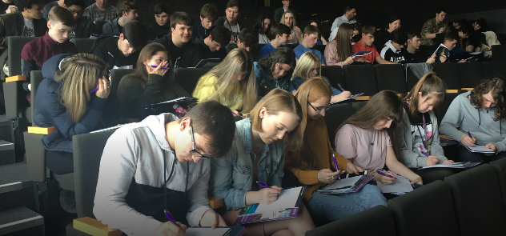










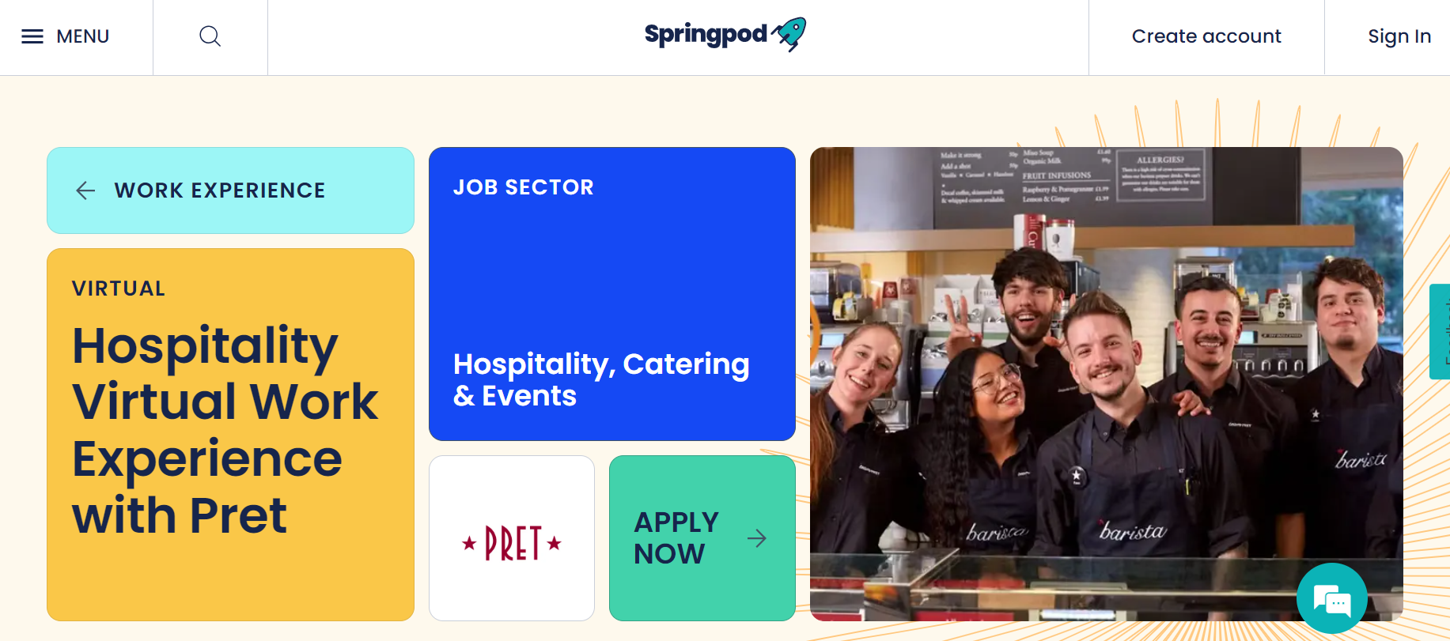





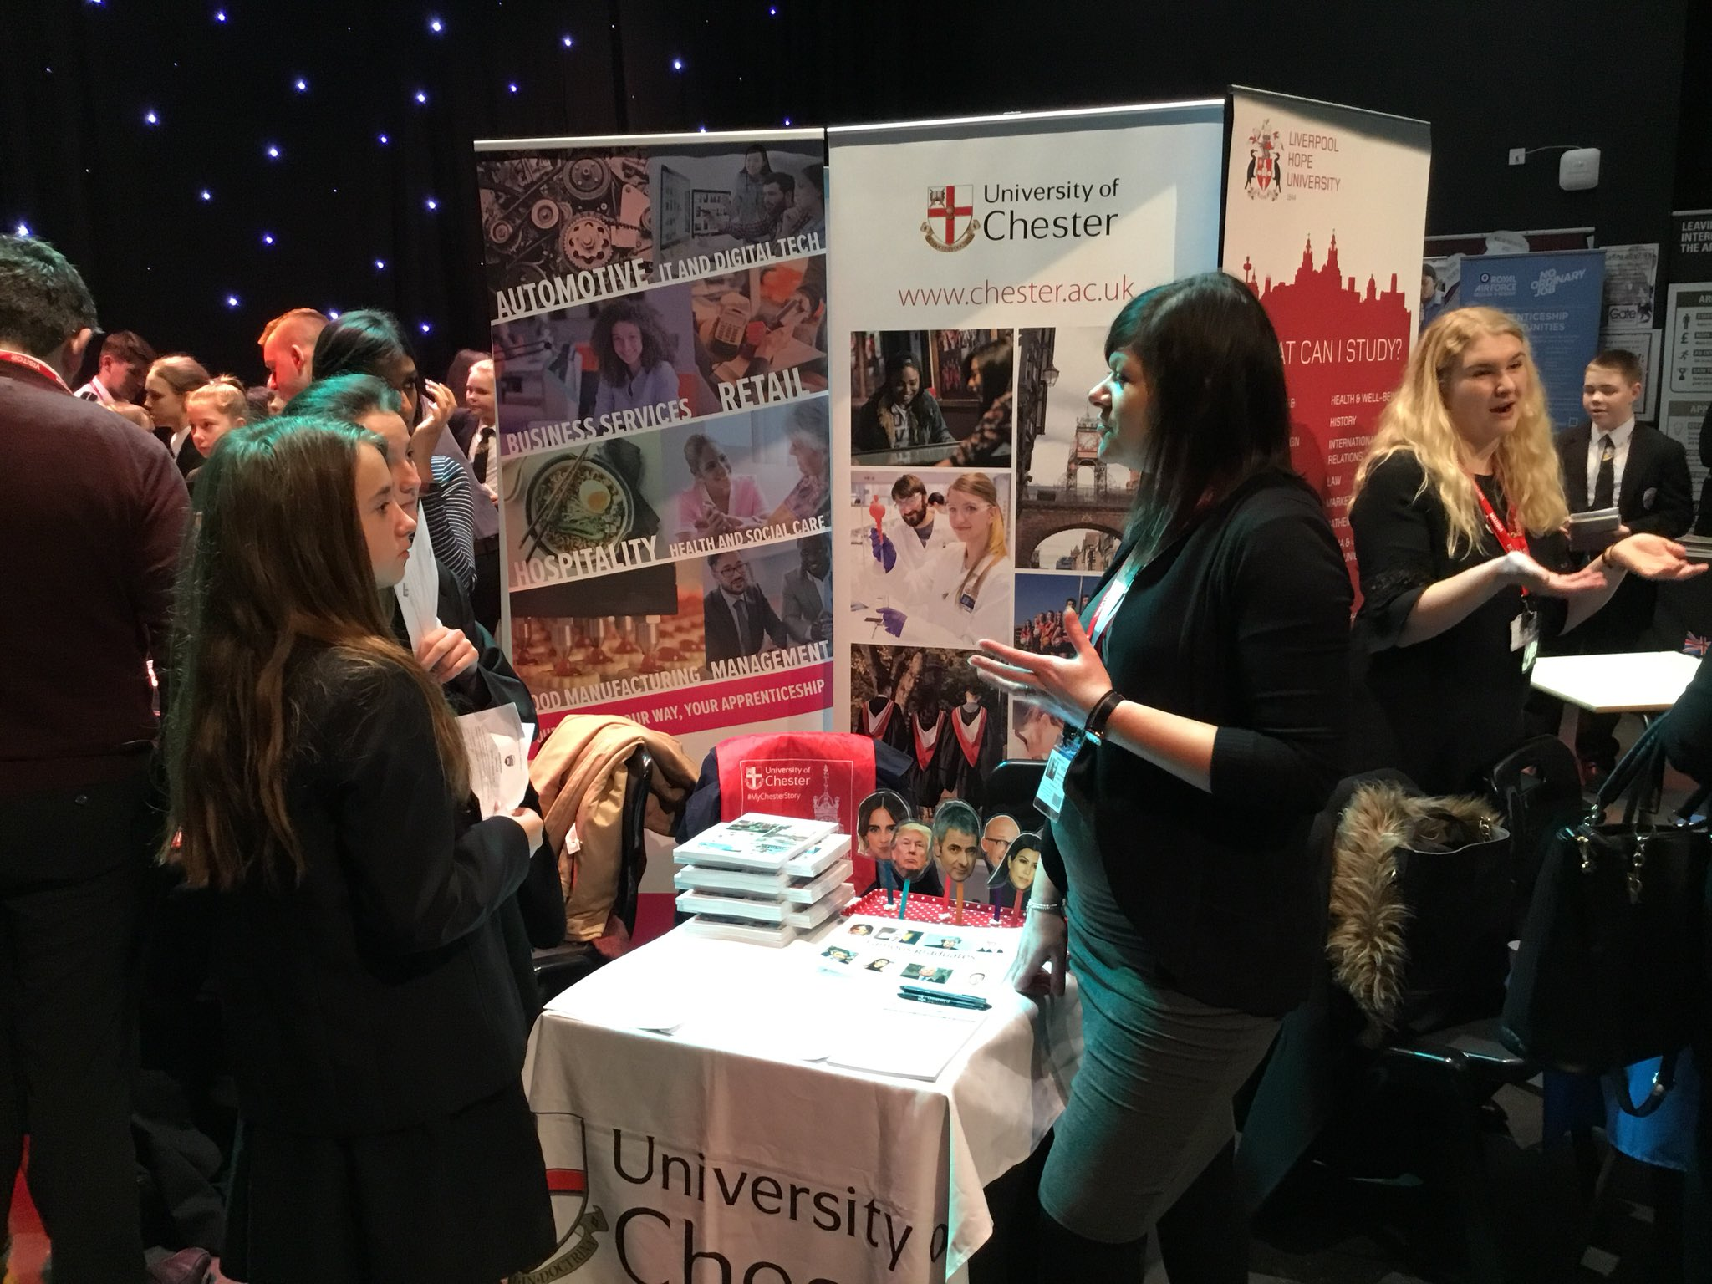




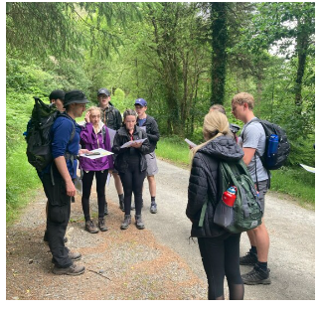







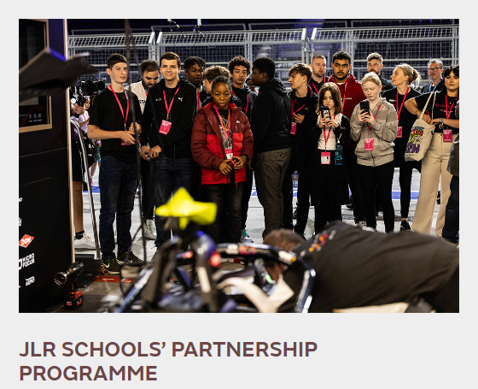

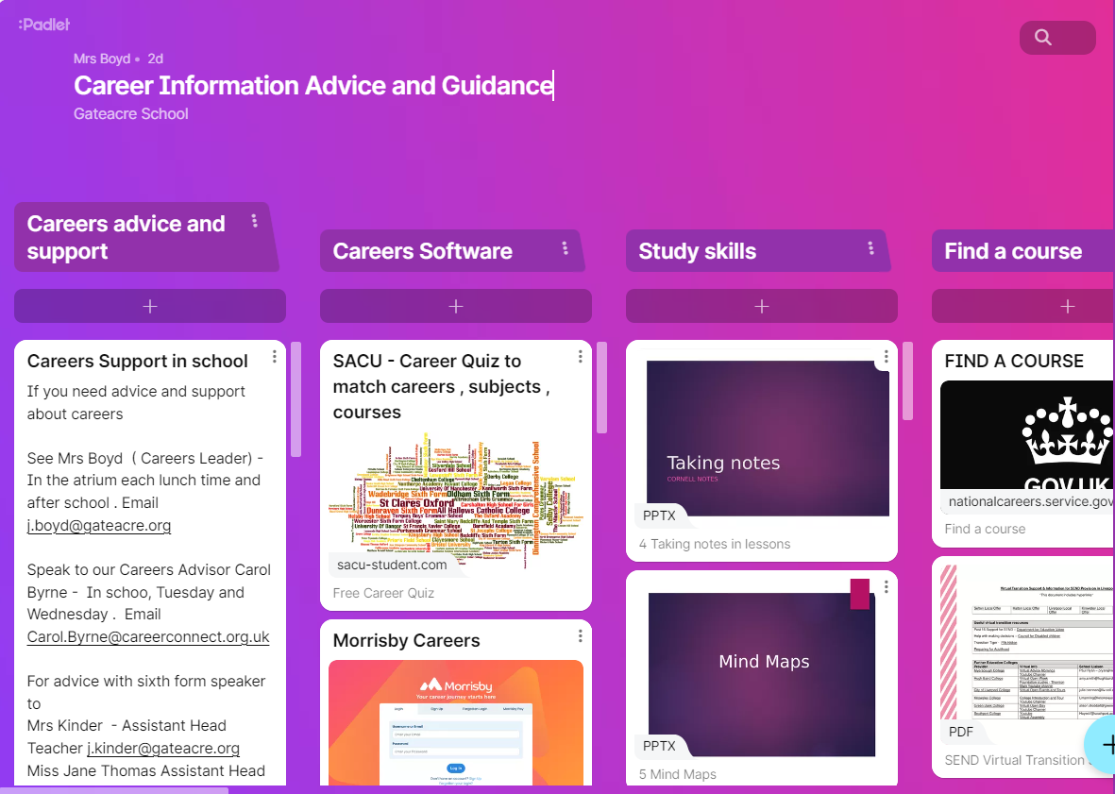
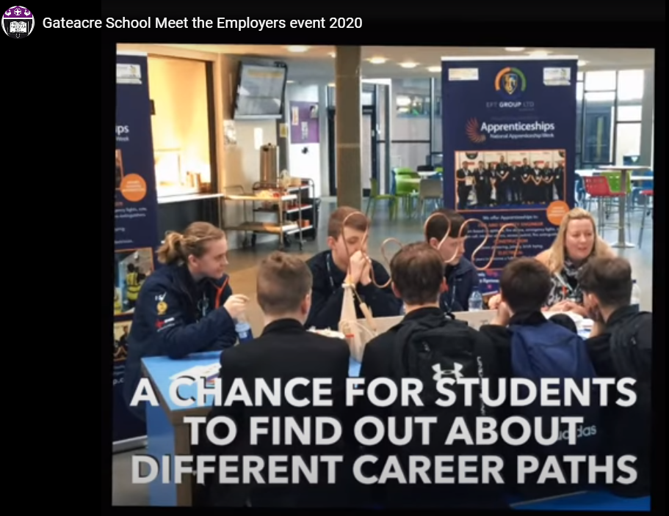




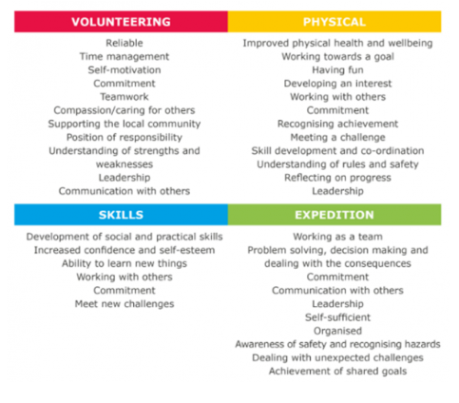











Gateacre School Careers Learning Journey
Visit To HE Providers
Annual Careers Fair
LJMU Student Finance Talk
1:1 support for CV Writing & Applications
Transition Support
Results day Careers Support
Destinations
University
Employment
Degree Apprenticeship
Apprenticeship
Year 13
Pathways to Law, Medicine, architecture
SACU Career and Subjects Research
Visit To HE Providers
UCAS Assemblies
UCAS Support Sessions
Personal Statements
Financial Capability
Independent Living Unit
Diversity in the workplace
Equality Act
Rights at Work
Visit To Paddington Village Employment Sector
Work ExperienceWeek
Work experience
preparation
Work Experience Launch Assemblies
Careers Unit
Workplace
visits
Year 12
Trips to HE
Work Experience Reflection
Stock Market Challenge
Gateacre sixth form interviews
Future Focus week
Career Connect Interviews
EPQ Sessons
Annual Careers Fair
Career drop in
SACU Career and Subjects Research
Sixth Form Mentor Progress sessions
Interview Preparation
Destinations
Employment
Gateacre Sixth Form
Sixth form College
Apprenticeship
Traineeship
A Levels
Applied qualifications
Technical/Vocational qualifications
T Levels
Civil Service Careers and apprenticeships Meet the employer
Transition
Year 11 Preparing to be successful
Weekly Careers Lessons
Careers assemblies with Careers Leader
Morrisby Career Development Planning
SACU Career and Subjects Research
Post 16 Provider Assemblies
Careers in English – Meet the Author
Year 11 Mentors
Assembly – Year 11 Journey & LMI
Year 11
Careers Fair
Applications
CV Sessions
Preparing for Interview
Virtual Careers Fair
1-1 Careers Interviews
Sixth Form Open Evening
Careers Action Planning
Apprenticeship Workshops
Work Experience
Careers Advisor at parents evening
Jaguar Landrover Careers Programme
D of E Expeditions
Assembly
Health and Safety in the Workplace
Careers Advisor at parents evening
Virtual Careers Fair
BigTrust
Employability Programme
Assembly - Year 10 Journey & LMI
Transition to KS4 Setting Goals
Being Successful
Civil Service Employability Mock Interviews
Assembly
Preparation for Work Experience
Year 10
Creative Careers
Ask Apprenticeships Assembly & Workshops
Workplace Visits
E.g. Study Skills, Time Management, STEM Careers
Careers Fair
Morrisby Research
Work Experience Launch - Assembly
Extra Curricular
Programme
Bands Night
Employer Engagement Adlib
KS4 Options Subject assemblies
Duke of Edinburgh
Student Amaassador and Leadership Roles
taking control of my future
Careers Fair
Options
Evening
Careers Research
Mental Heath and Wellbeing
Options Assembly
British Science Week
Prejudice, stereotypes and discrimination
Options Presentations
Goals Employability Programme
E.g. Coping with stress & managing anxiety
Apprenticeship Insight Assemblies
Career Padlet
Virtual Work Experience
Careers Sessions “Making Decisions
BBC Bitesize Careers and apprenticeships
Virtual Work Experience
Bank of England Careers in banking
Year 9
BBC Bitesize Careers and Apprenticeship Workshop
Employability Skills Workshops DHL
Careers Research
Careers Action Plan
STEM Club
Channel 4 meet the employers Q and A
Problem Solving
Extra Curricular
Programme
Careers Activity Log
Careers Assembly LMI
Annual Careers Fair
Why Work? My motivation
Reflecting on my Achievements
My Skills and Qualities
Icould Buzz Quiz
STEM Club
Careers Research icould
Careers In Technology at The Bank Of England Virtual Workshop
Careers Activity Log
Mentor Time Booklet “Thinking Ahead”
Reflecting on my Achievements
Year 8
Mental Health
Year 8 Experience of a workplace
School Office
Transition week
Career Pilot
National Careers Week
BBC Bitesize Careers and apprenticeships
Extra Curricular
Programme
E.g. growth mindset, target setting, behaviour to achieve
Welcome to Year 7
Meet our teachers
Careers information is available from:
The school website
The careers padlet
Displays around the school
Your subject teachers
Mrs Boyd– Careers Leader
Carol Byrne– Careers Adviser
Gemma Silvano – Careers Advisor
Mrs Kinder Assistant Headteacher Sixth Form
Year 11 Mentors
Morrissby Careers
Bemore Portal
Year 7
Primary School
Transition events
Summer School
Attend
Taster Day
Transition meet the staff
Visit our open evening

